Slide 1
Offline Planning in MDPs
Tom Silver
Robot Planning Meets Machine Learning
Princeton University
Fall 2025

Slide 2
Building Toward MDPs

Slide 3
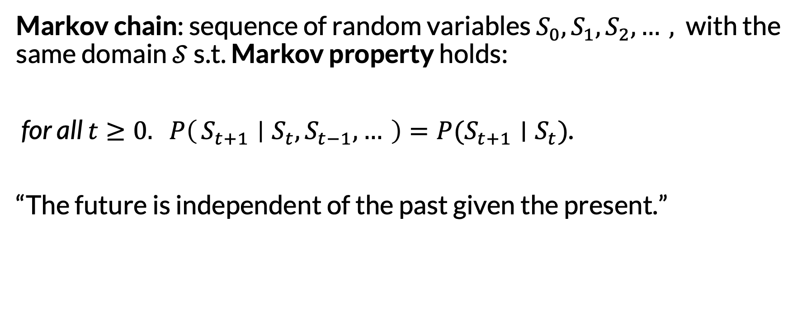
Markov Chains
Markov chain: sequence of random variables $S_{0}, S_{1}, S_{2},…,$with the same domain $𝒮$ s.t. Markov property holds:
for all $t≥0. P\left(S_{t+1} ∣ S_{t}, S_{t−1}, …\right)=P(S_{t+1}∣S_{t})$.
“The future is independent of the past given the present.”

Slide 4

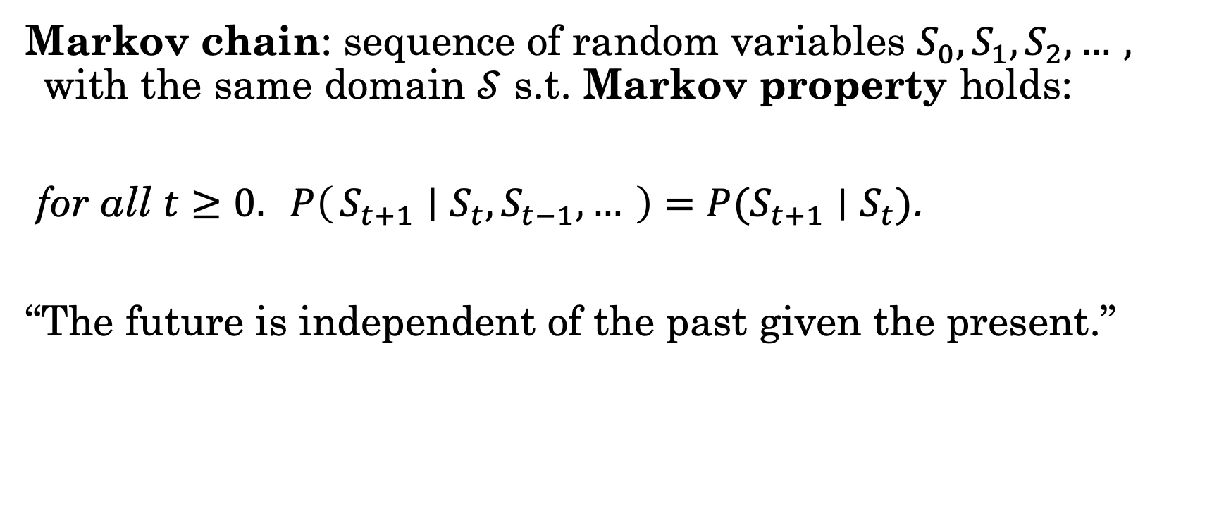
Markov Chains
Each $S_{t}$ represents a state
Markov chain: sequence of random variables $S_{0}, S_{1}, S_{2},…,$with the same domain $𝒮$ s.t. Markov property holds:
for all $t≥0. P\left(S_{t+1} ∣ S_{t}, S_{t−1}, …\right)=P(S_{t+1}∣S_{t})$.
“The future is independent of the past given the present.”
The state space

Slide 5
Markov Chains
Markov chain: sequence of random variables $S_{0}, S_{1}, S_{2},…,$with the same domain $𝒮$ s.t. Markov property holds:
for all $t≥0. P\left(S_{t+1} ∣ S_{t}, S_{t−1}, …\right)=P(S_{t+1}∣S_{t})$.
“The future is independent of the past given the present.”
Assuming discrete time

Slide 6
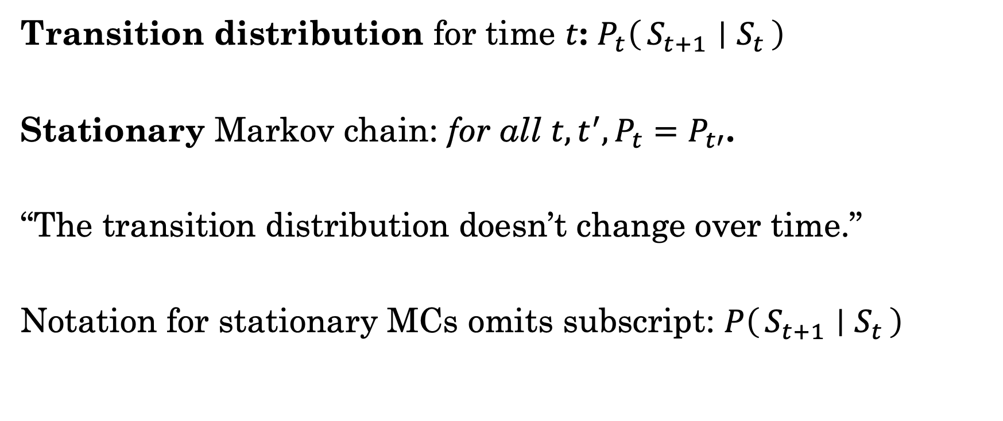
Markov Chains
Transition distribution for time $t$: $P_{t}\left(S_{t+1} ∣ S_{t}\right)$
Stationary Markov chain: for all $t, t^{′}, P_{t}=P_{t′}$.
“The transition distribution doesn’t change over time.”
Notation for stationary MCs omits subscript: $P\left(S_{t+1} ∣ S_{t}\right)$
a.k.a. time-homogeneous

Slide 7
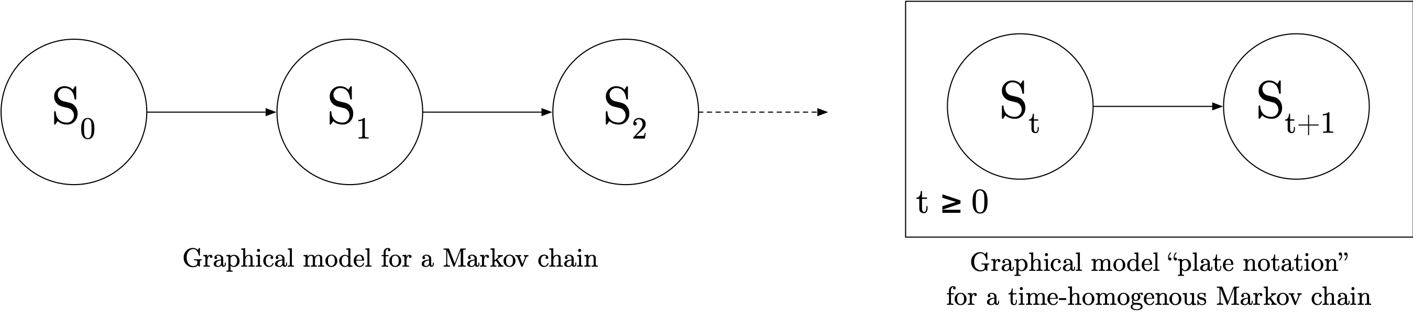
Markov Chain PGM

Slide 8

Example
How would we represent this scenario as a Markov Chain?

Slide 9
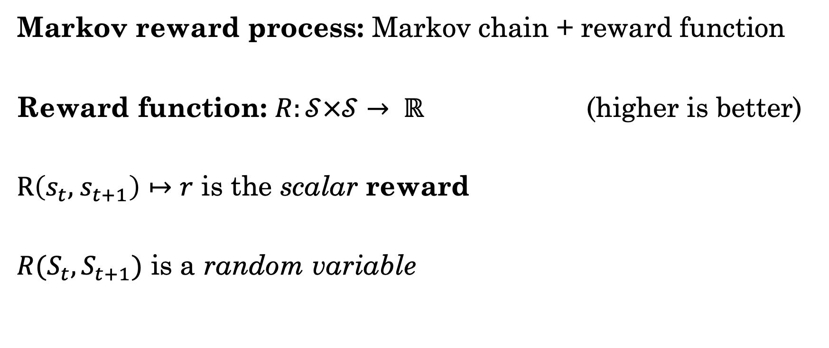
Markov Reward Processes
Markov reward process: Markov chain + reward function
Reward function: $R:𝒮×𝒮→ ℝ$ (higher is better)
$R\left(s_{t}, { s}_{t+1}\right)↦r$ is the scalar reward
$R(S_{t}, S_{t+1})$ is a random variable

Slide 10
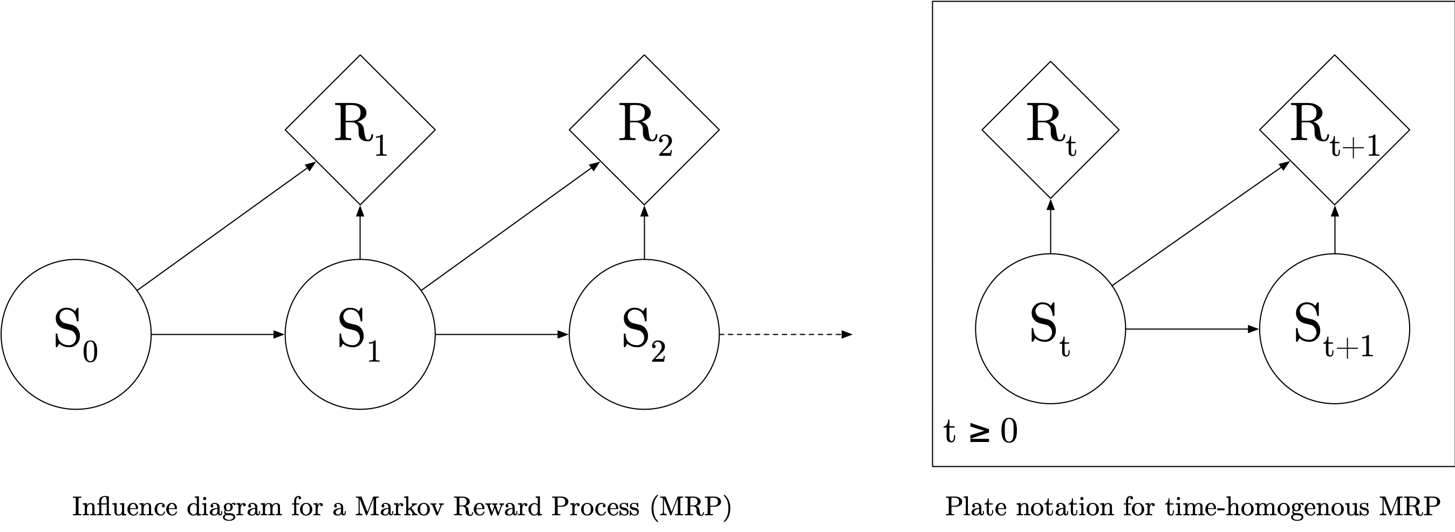
MRP PGM (Influence Diagram)
Influence diagrams are an extension of Bayes nets that include “reward nodes” (diamonds)

Slide 11

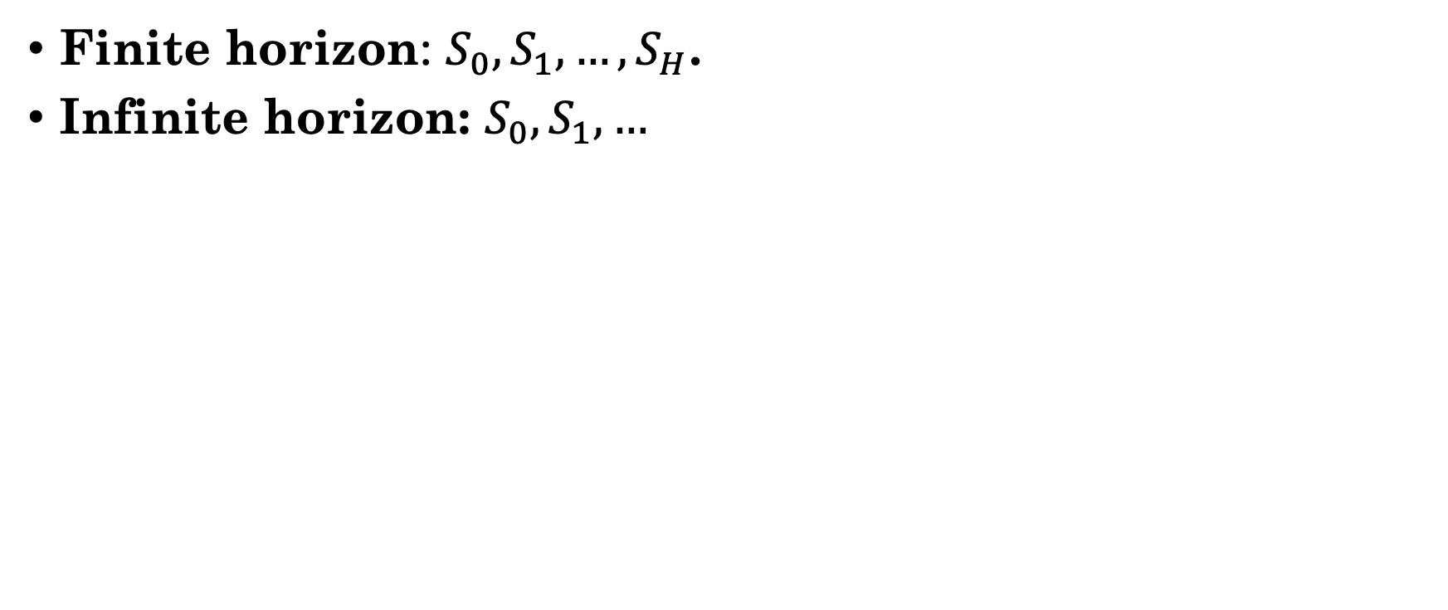
Time Horizons
$H$ is the horizon
Finite horizon: $S_{0}, S_{1}, …, S_{H}$.
Infinite horizon: $S_{0}, S_{1}, …$

Slide 12
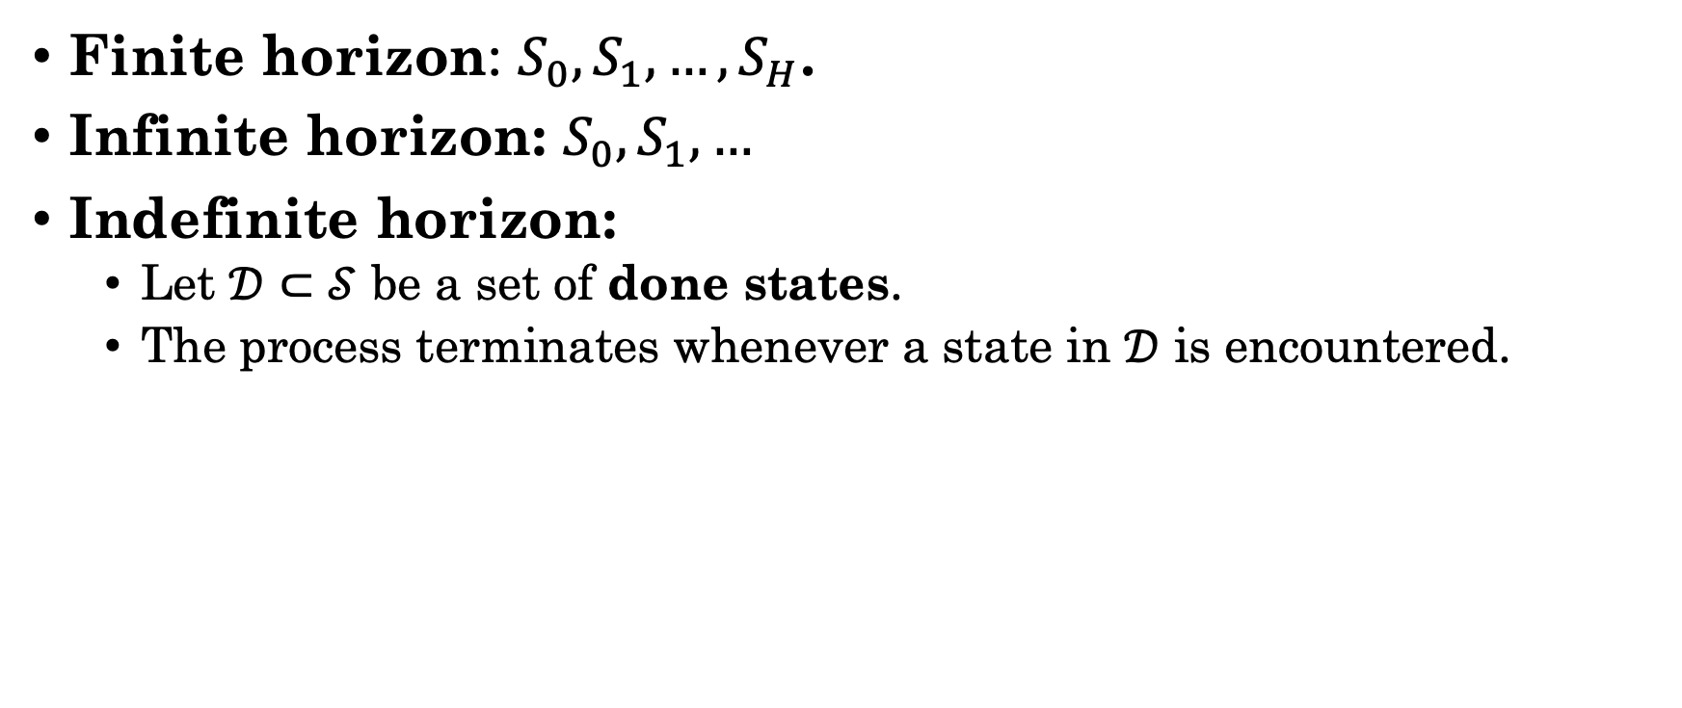
Time Horizons
Finite horizon: $S_{0}, S_{1}, …, S_{H}$.
Infinite horizon: $S_{0}, S_{1}, …$
Indefinite horizon:
Let $𝒟⊂𝒮$ be a set of done states.
The process terminates whenever a state in $𝒟$ is encountered.
a.k.a. sink states, terminal states, absorbing states

Slide 13
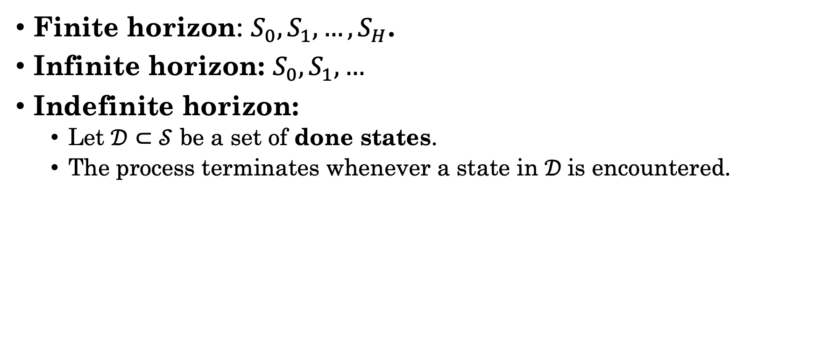
Time Horizons
Finite horizon: $S_{0}, S_{1}, …, S_{H}$.
Infinite horizon: $S_{0}, S_{1}, …$
Indefinite horizon:
Let $𝒟⊂𝒮$ be a set of done states.
The process terminates whenever a state in $𝒟$is encountered.
For indefinite horizon, usually assume that we will reach a done state with probability 1.

Slide 14
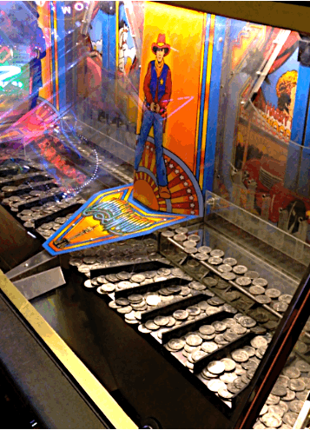
Example
How would we represent this scenario as an MRP?

Slide 15
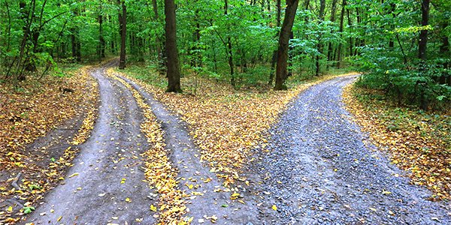
MRP 1
MRP 2

Slide 16
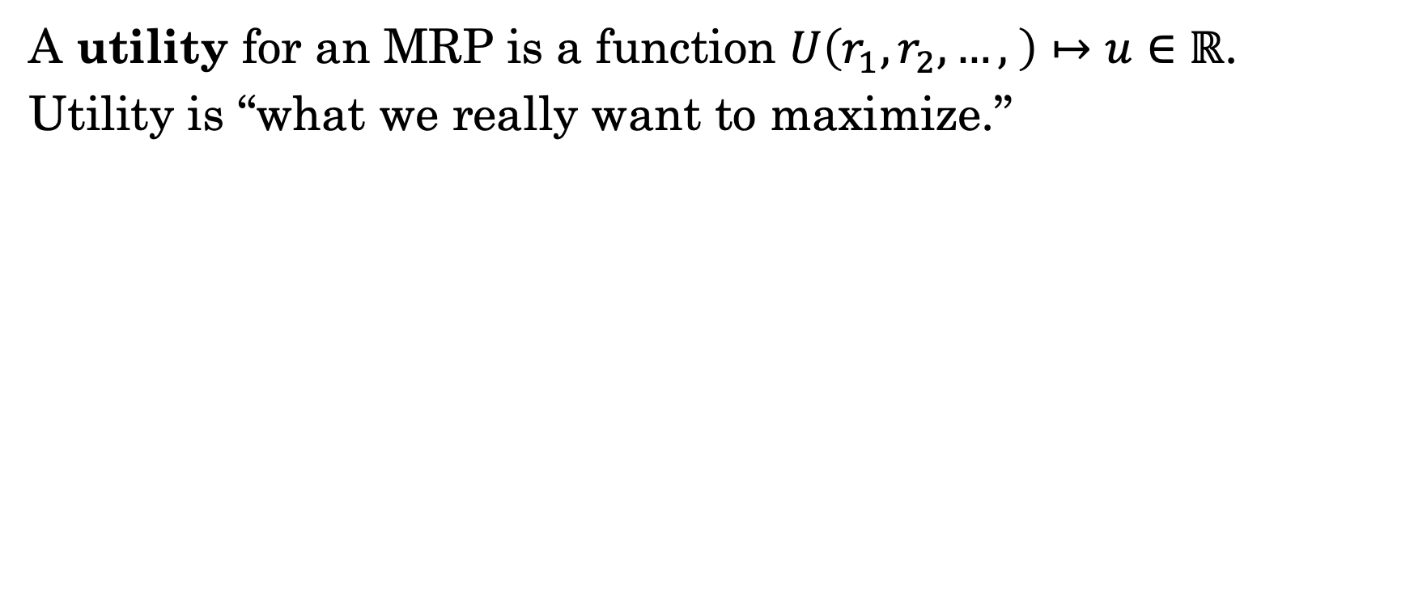
Utilities
A utility for an MRP is a function $U\left(r_{1}, r_{2}, …, \right)↦u∈ℝ$.
Utility is “what we really want to maximize.”

Slide 17

Utilities
A utility for an MRP is a function $U\left(r_{1}, r_{2}, …, \right)↦u∈ℝ$.
Utility is “what we really want to maximize.”
I need money now! ASAP!!!
If I get money now, a bully would take it. Better to wait.
What would each agent’s utility look like?

Slide 18
Utilities
A utility for an MRP is a function $U\left(r_{1}, r_{2}, …, \right)↦u∈ℝ$.
Utility is “what we really want to maximize.”
I just want to know what it feels like to score big. Just once is enough.
I really, really don’t want to fail.
What would each agent’s utility look like?

Slide 19
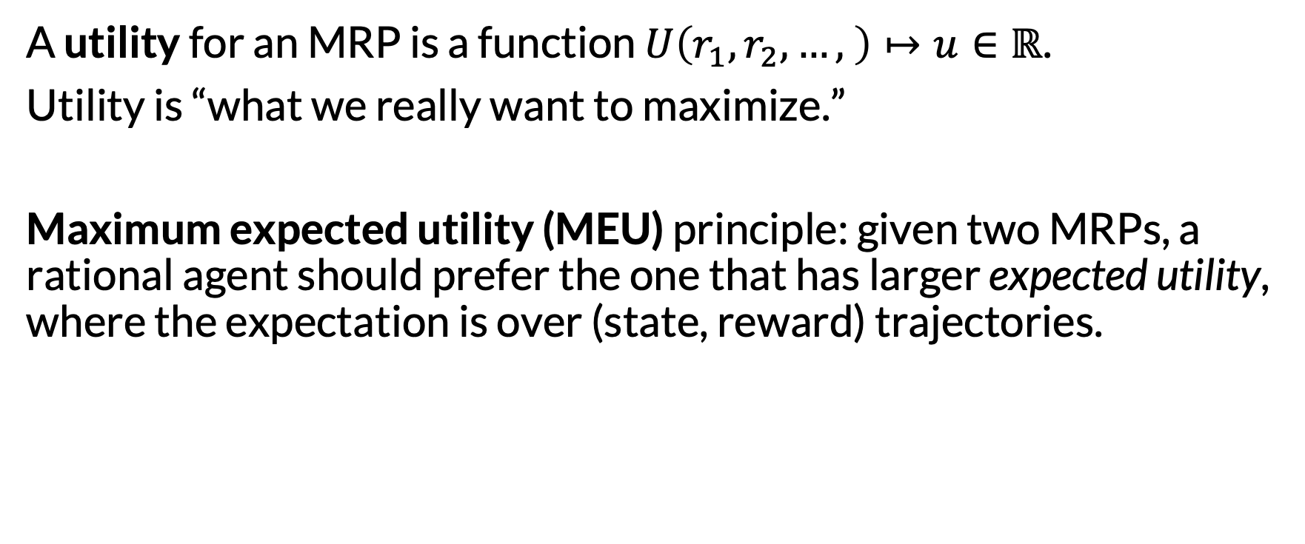
Utilities
A utility for an MRP is a function $U\left(r_{1}, r_{2}, …, \right)↦u∈ℝ$.
Utility is “what we really want to maximize.”
Maximum expected utility (MEU) principle: given two MRPs, a rational agent should prefer the one that has larger expected utility, where the expectation is over (state, reward) trajectories.

Slide 20
Utilities
A utility for an MRP is a function $U\left(r_{1}, r_{2}, …, \right)↦u∈ℝ$.
Utility is “what we really want to maximize.”
Maximum expected utility (MEU) principle: given two MRPs, a rational agent should prefer the one that has larger expected utility, where the expectation is over (state, reward) trajectories.
Note: for the moment, we’re assuming some distribution over initial states.

Slide 21
Utilities
A utility for an MRP is a function $U\left(r_{1}, r_{2}, …, \right)↦u∈ℝ$.
Utility is “what we really want to maximize.”
Maximum expected utility (MEU) principle: given two MRPs, a rational agent should prefer the one that has larger expected utility, where the expectation is over (state, reward) trajectories.
Seems reasonable, but is this the only option?

Slide 22
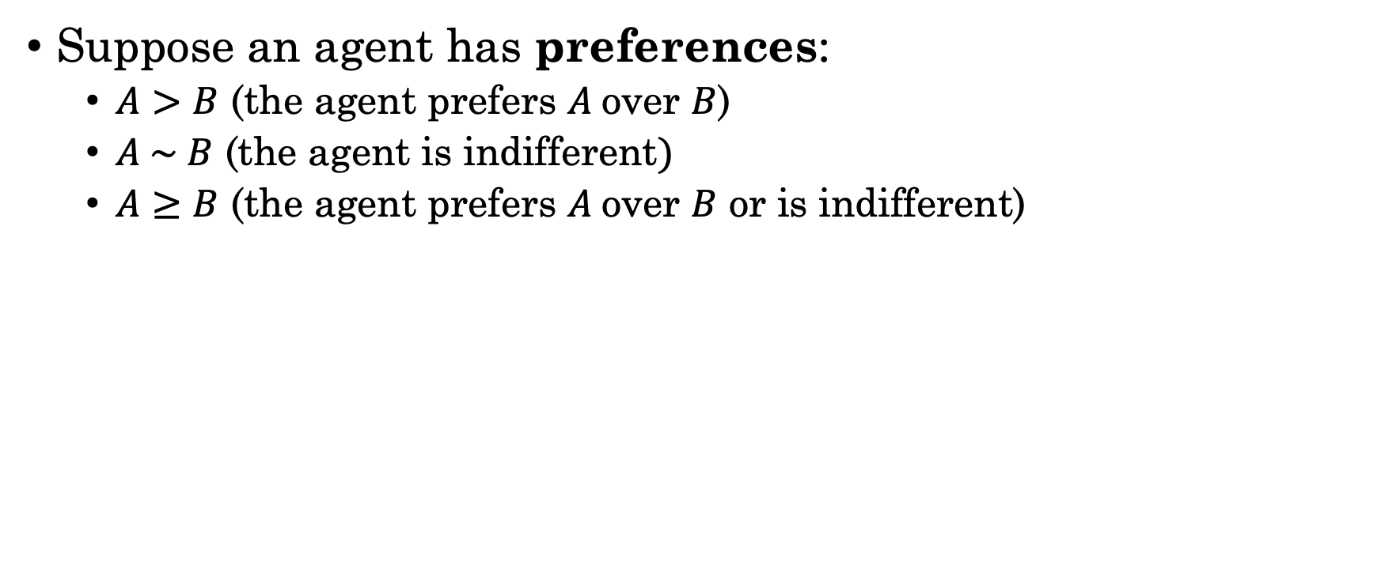
Preferences, Axioms of Utility Theory
Suppose an agent has preferences:
$A>B$ (the agent prefers $A$over $B$)
$A \sim B$ (the agent is indifferent$)$
$A≥B$ (the agent prefers $A$over $B$ or is indifferent)
What are A and B here? Formally: lotteries.
For our purposes: MRPs.

Slide 23
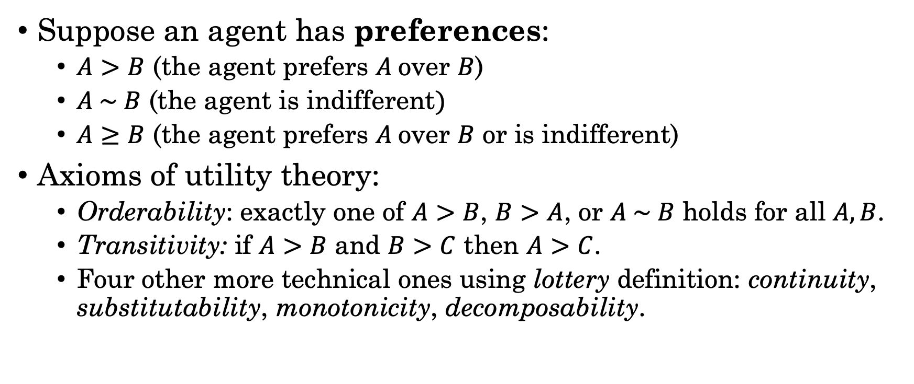
Preferences, Axioms of Utility Theory
Suppose an agent has preferences:
$A>B$ (the agent prefers $A$over $B$)
$A \sim B$ (the agent is indifferent$)$
$A≥B$ (the agent prefers $A$over $B$ or is indifferent)
Axioms of utility theory:
Orderability: exactly one of $A>B$, $B>A$, or $A \sim B$ holds for all $A, B$.
Transitivity: if $A>B$ and $B>C$ then $A>C$.
Four other more technical ones using lottery definition: continuity, substitutability, monotonicity, decomposability.

Slide 24
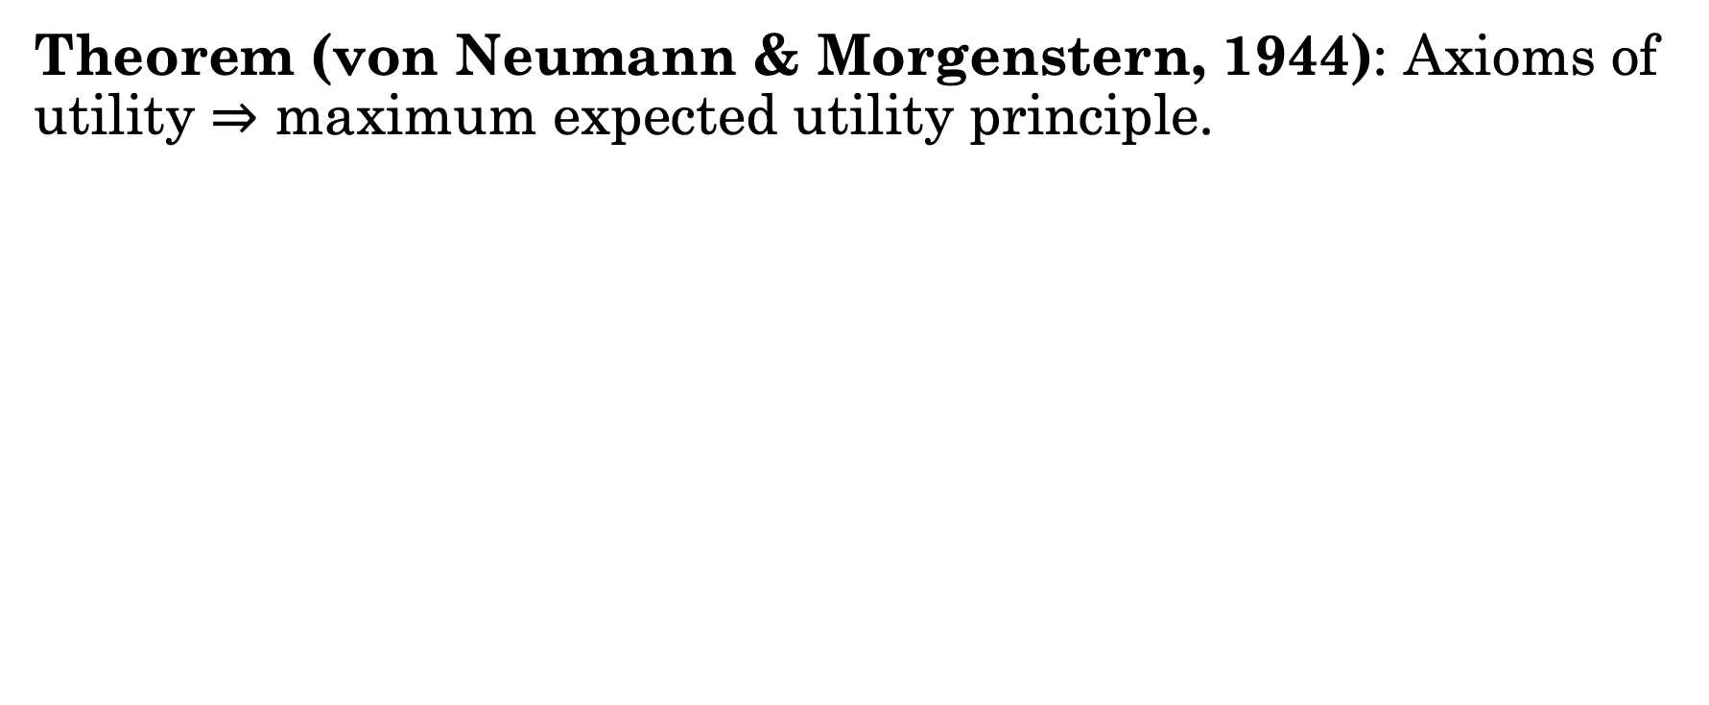
Preferences, Axioms of Utility Theory
Theorem (von Neumann & Morgenstern, 1944): Axioms of utility $⇒$ maximum expected utility principle.
So, if we accept the axioms, then MEU is what we need.

Slide 25

Our Agent’s Utility vs Our Own
Value Alignment Problem
Need to be very careful & thoughtful about utility definitions!
Difficult to capture all societal norms
Famous example: paperclip maximizer (Bostrom 2003)
Right: another example (OpenAI 2016)

Slide 26
Utilities
A utility for an MRP is a function $U\left(r_{1}, r_{2}, …, \right)↦u∈ℝ$.
Utility is “what we really want to maximize.”
Maximum expected utility (MEU) principle: given two MRPs, a rational agent should prefer the one that has larger expected utility, where the expectation is over (state, reward) trajectories.
But MRPs don’t have an initial state distribution! Let’s revisit…
Note: for the moment, we’re assuming some distribution over initial states.

Slide 27
MRP 1
MRP 2
Initial state 1
Initial state 2

Slide 28
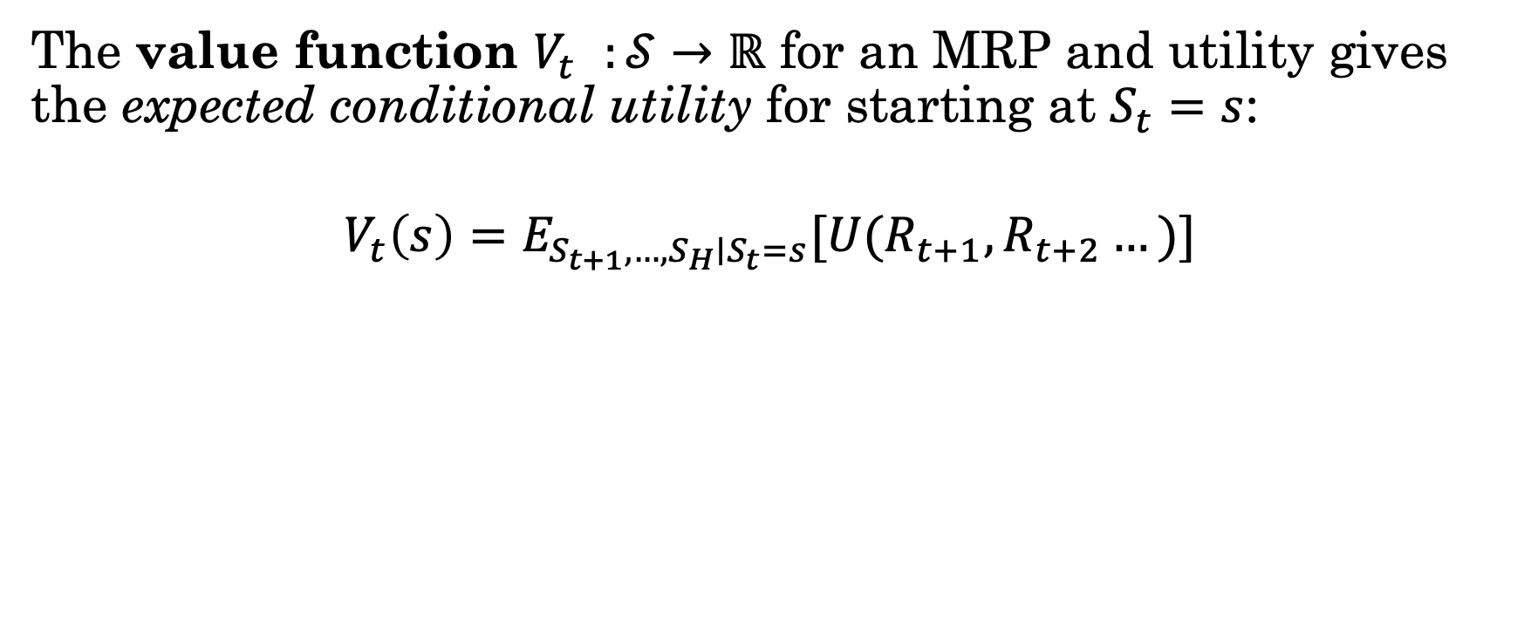
Value Functions
The value function $V_{t}^{}:𝒮→$ $ℝ$ for an MRP and utility gives the expected conditional utility for starting at $S_{t}=s$:
$$V_{t}\left(s\right)=E_{S_{t+1}, …, S_{H}∣S_{t}=s}[U(R_{t+1},R_{t+2}…)]$$

Slide 29
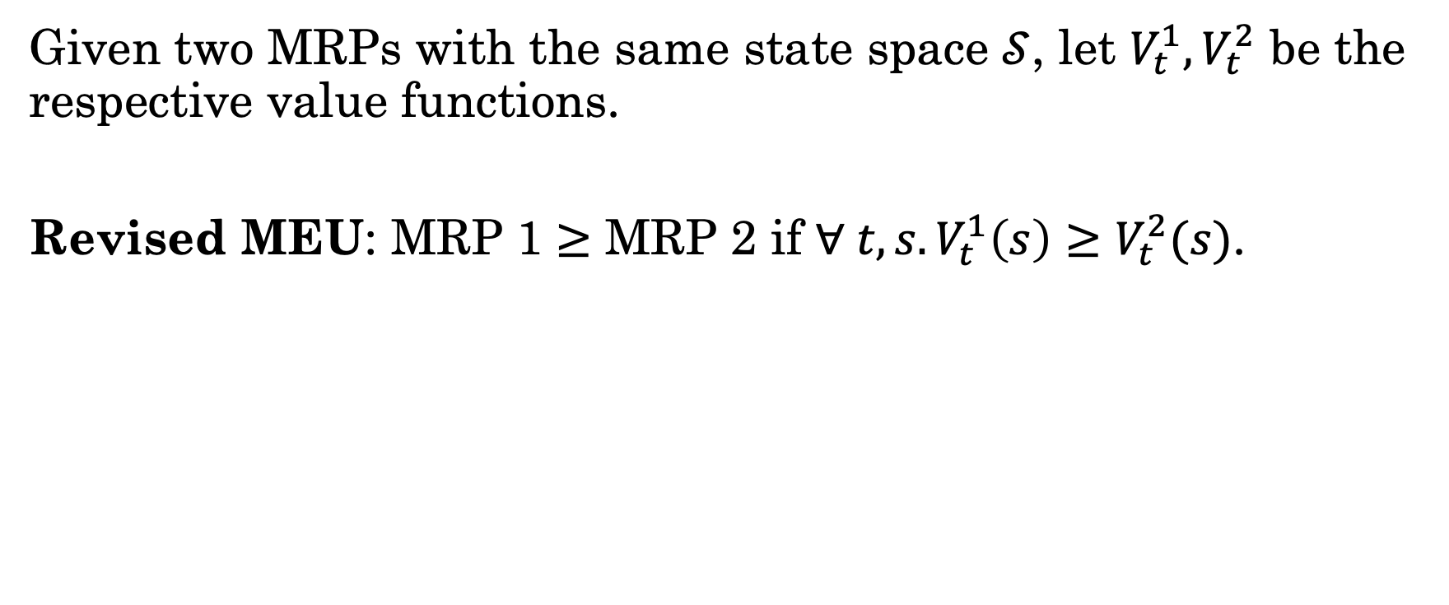
Revised MEU for MRPs
Given two MRPs with the same state space $𝒮$, let $V_{t}^{1},V_{t}^{2}$ be the respective value functions.
Revised MEU: MRP 1 $≥$ MRP 2 if $∀ t, s. V_{t}^{1}\left(s\right)≥$ $V_{t}^{2}(s)$.
“I prefer MRP 1 over MRP2 (or am indifferent) if for any time and state, the expected conditional utility for MRP1 is at least that of MRP2.”

Slide 30
Revised MEU for MRPs
Given two MRPs with the same state space $𝒮$, let $V_{t}^{1},V_{t}^{2}$ be the respective value functions.
Revised MEU: MRP 1 $≥$ MRP 2 if $∀ t, s. V_{t}^{1}\left(s\right)≥$ $V_{t}^{2}(s)$.
How to evaluate in practice?
“I prefer MRP 1 over MRP2 (or am indifferent) if for any time and state, the expected conditional utility for MRP1 is at least that of MRP2.”

Slide 31
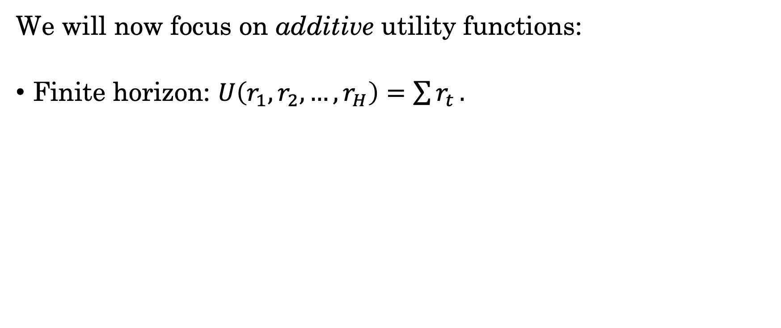
Additive Utility Functions
We will now focus on additive utility functions:
Finite horizon: $U\left(r_{1}, r_{2}, …, r_{H}\right)=\sum{r_{t}}.$

Slide 32
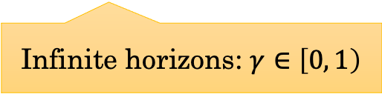
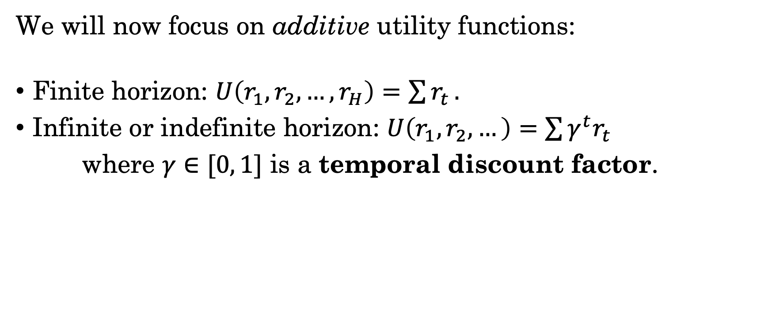
Additive Utility Functions
We will now focus on additive utility functions:
Finite horizon: $U\left(r_{1}, r_{2}, …, r_{H}\right)=\sum{r_{t}}.$
Infinite or indefinite horizon: $U\left(r_{1}, r_{2}, …\right)=\sum{γ^{t}r_{t}}$
where $γ∈[0, 1]$ is a temporal discount factor.
Infinite horizons: $γ∈\left[0, 1\right)$

Slide 33
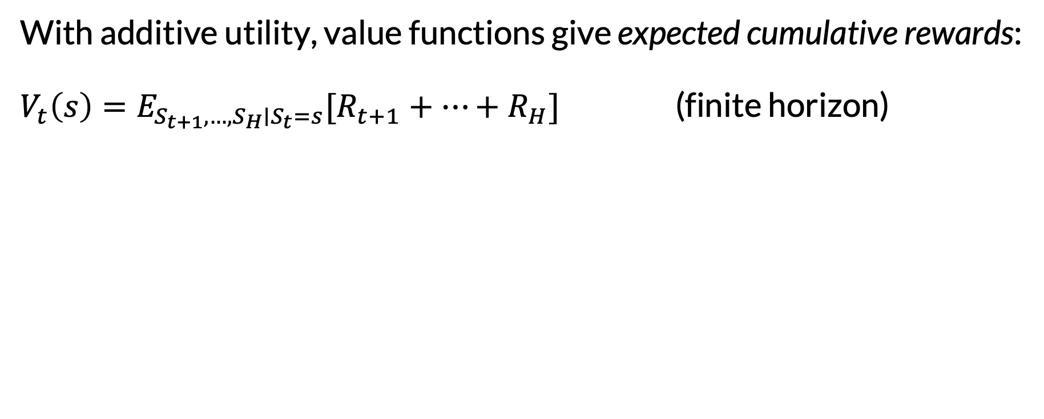
Value Functions with Additive Utility
With additive utility, value functions give expected cumulative rewards: $V_{t}\left(s\right)=E_{S_{t+1}, …, S_{H}∣S_{t}=s}[R_{t+1}+…+R_{H}]$ (finite horizon)

Slide 34
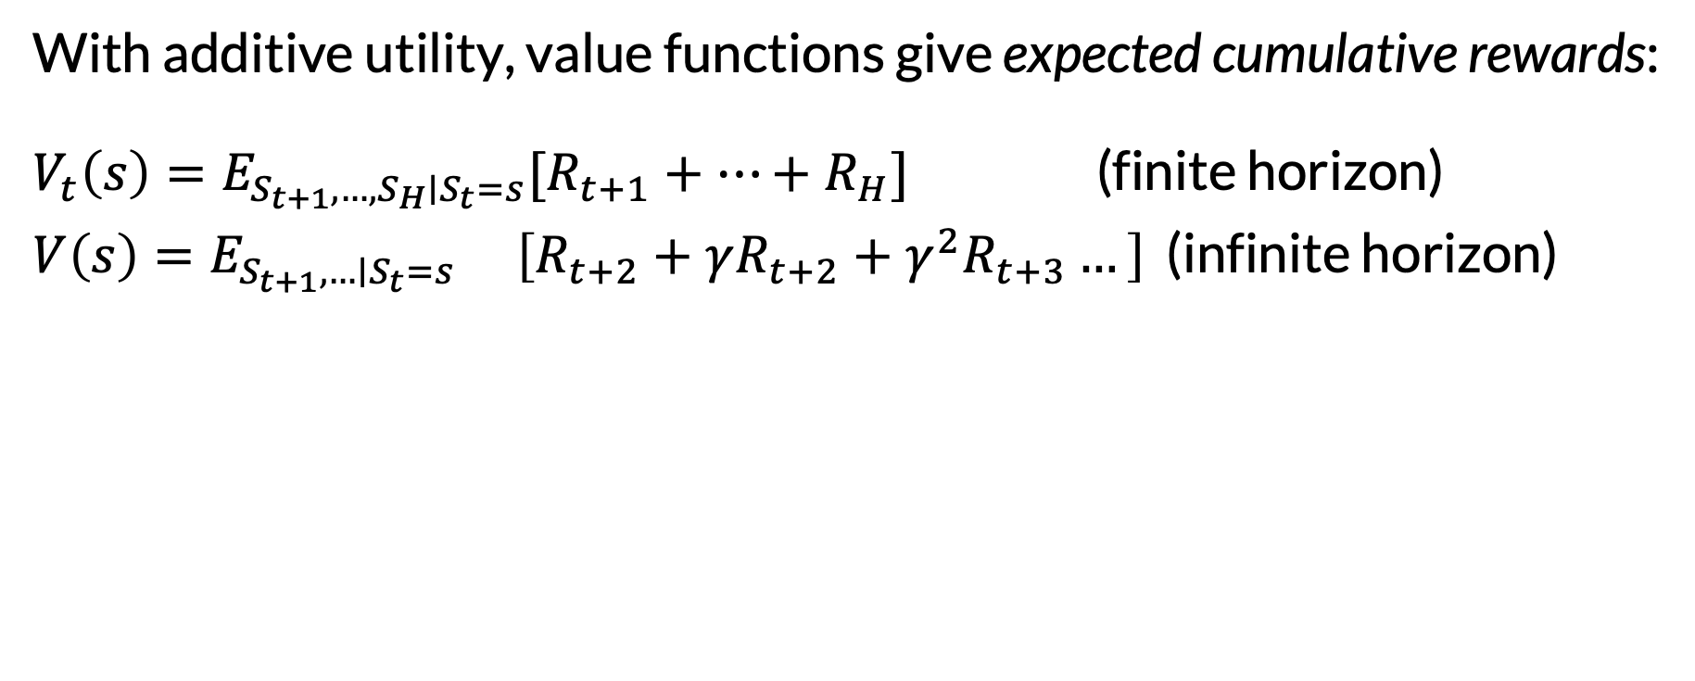
Value Functions with Additive Utility
With additive utility, value functions give expected cumulative rewards: $V_{t}\left(s\right)=E_{S_{t+1}, …, S_{H}∣S_{t}=s}[R_{t+1}+…+R_{H}]$ (finite horizon)
$V\left(s\right)=E_{S_{t+1}, …∣S_{t}=s} \left[R_{t+2}+γR_{t+2}+{γ^{2}R}_{t+3}…\right]$ (infinite horizon)
No need for time subscripts in infinite horizon case

Slide 35
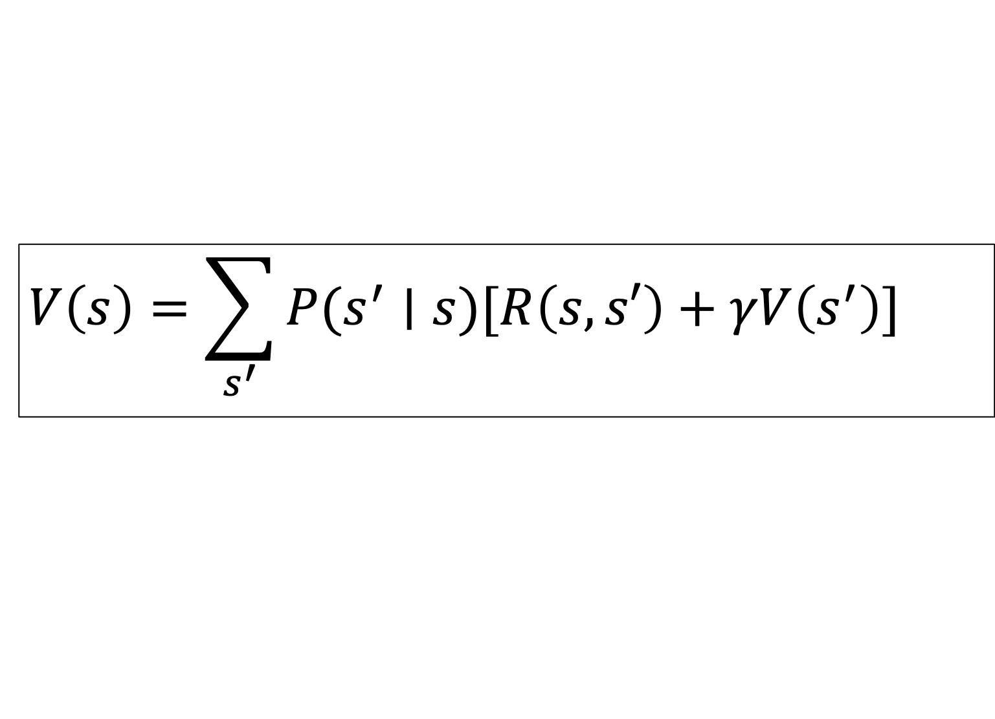
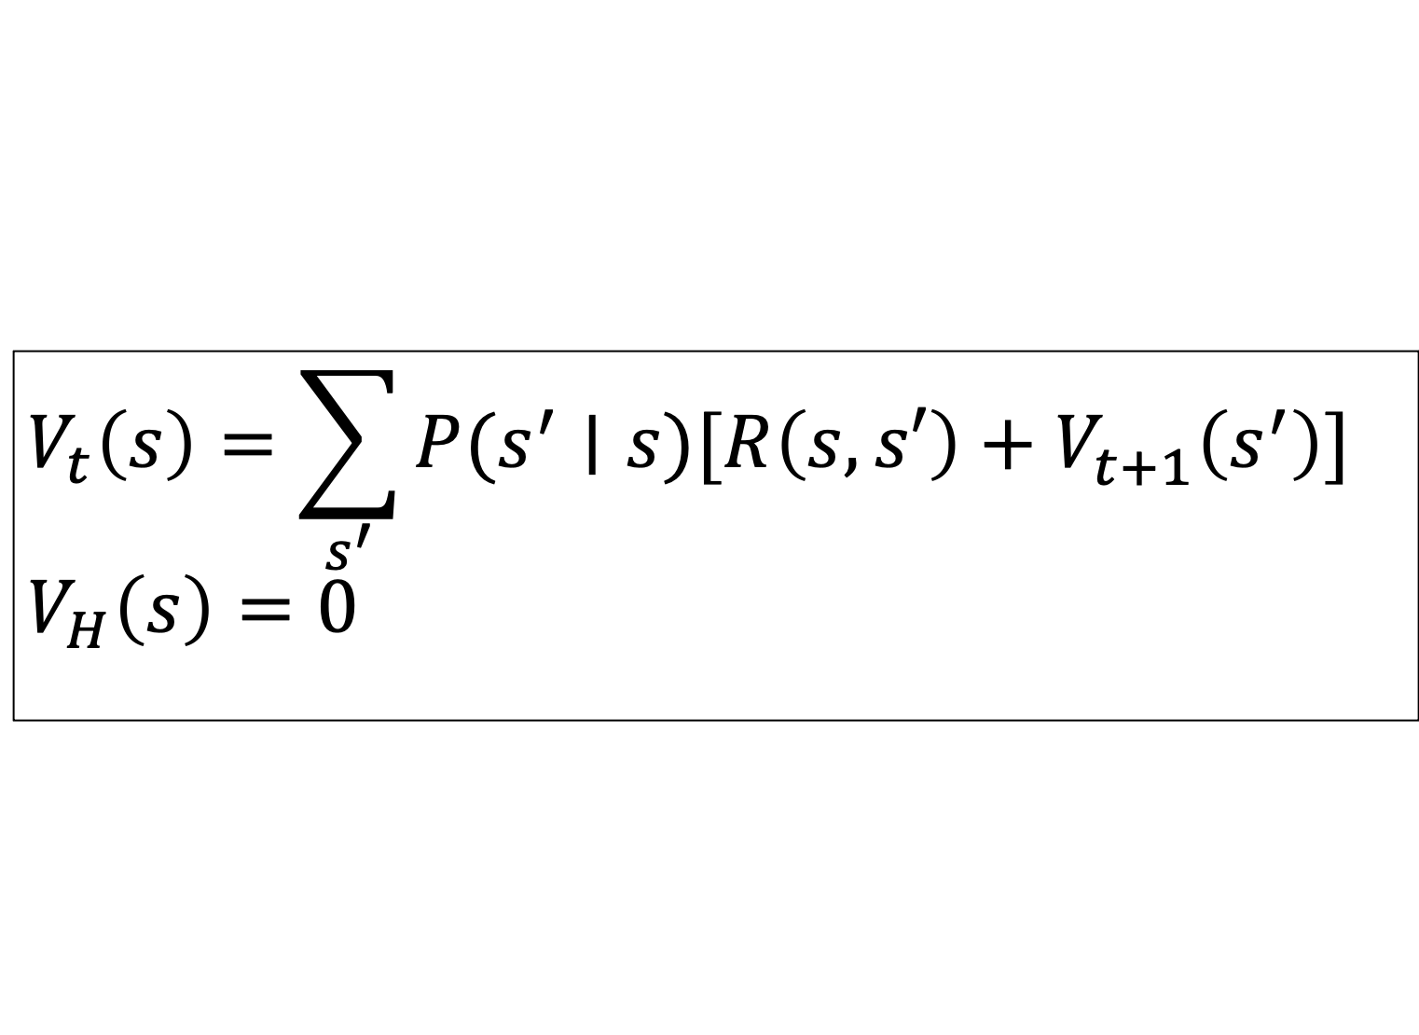
Bellman Equations: Convenient Recursions
Finite Horizon
$$V_{t}\left(s\right)=\sum_{s^{′}}{P(s^{′}∣s)[R\left(s, s′\right)+V_{t+1}^{}\left(s^{′}\right)]}$$
$$V_{H}\left(s\right)=0$$
Immediate reward
Future rewards
Infinite Horizon
$$V\left(s\right)=\sum_{s^{′}}{P(s^{′}∣s)[R\left(s, s′\right)+γV\left(s^{′}\right)]}$$

Slide 36
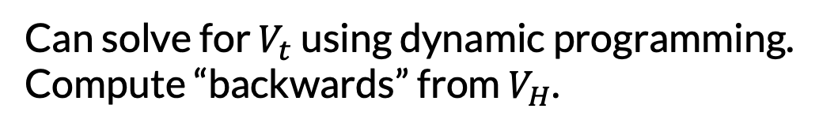
Bellman Equations: Convenient Recursions
Finite Horizon
$$V_{t}\left(s\right)=\sum_{s^{′}}{P(s^{′}∣s)[R\left(s, s′\right)+V_{t+1}^{}\left(s^{′}\right)]}$$
$$V_{H}\left(s\right)=0$$
Can solve for $V_{t}$ using dynamic programming.
Compute “backwards” from $V_{H}$.

Slide 37
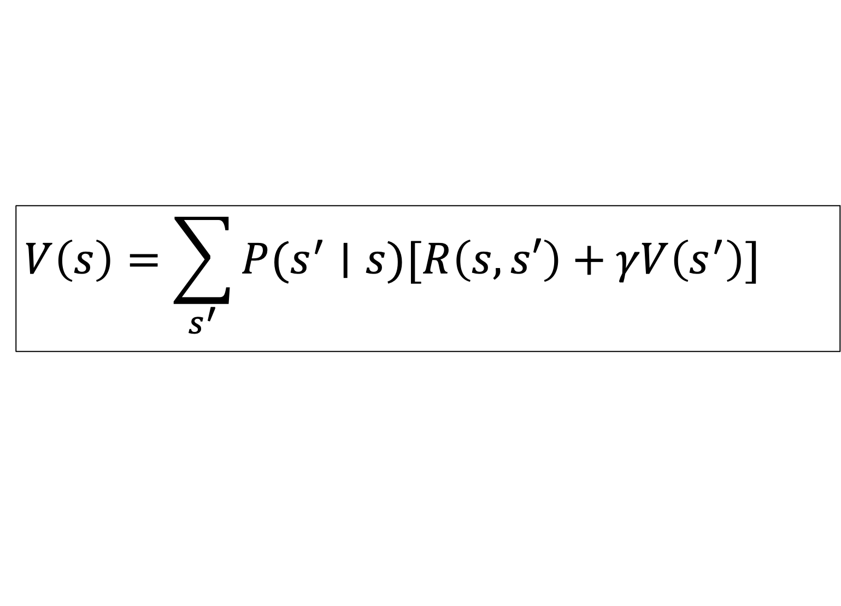
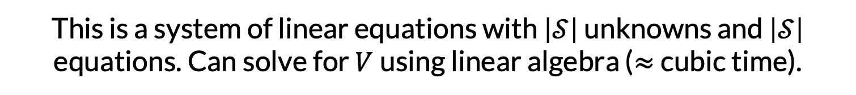
Bellman Equations: Convenient Recursions
This is a system of linear equations with $\left|𝒮\right|$ unknowns and $\left|𝒮\right|$ equations. Can solve for $V$using linear algebra ($≈$cubic time).
Infinite Horizon
$$V\left(s\right)=\sum_{s^{′}}{P(s^{′}∣s)[R\left(s, s′\right)+γV\left(s^{′}\right)]}$$

Slide 38
Recap
How to choose an MRP?
Solve Bellman equations to get value functions.
Check preference property: does one value function “dominate” the other, across all states?
MRP 1
MRP 2
Now assuming:
Shared state space
Additive utility

Slide 39
Toward Sequential Decision-Making
Given a choice between MRPs, we now know how to pick our favorite one.
This is one-time decision making, at the MRP level.
What if we get to make decisions at each time step, influencing the distribution over next states?

Slide 40
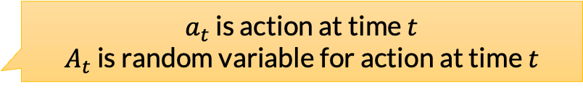
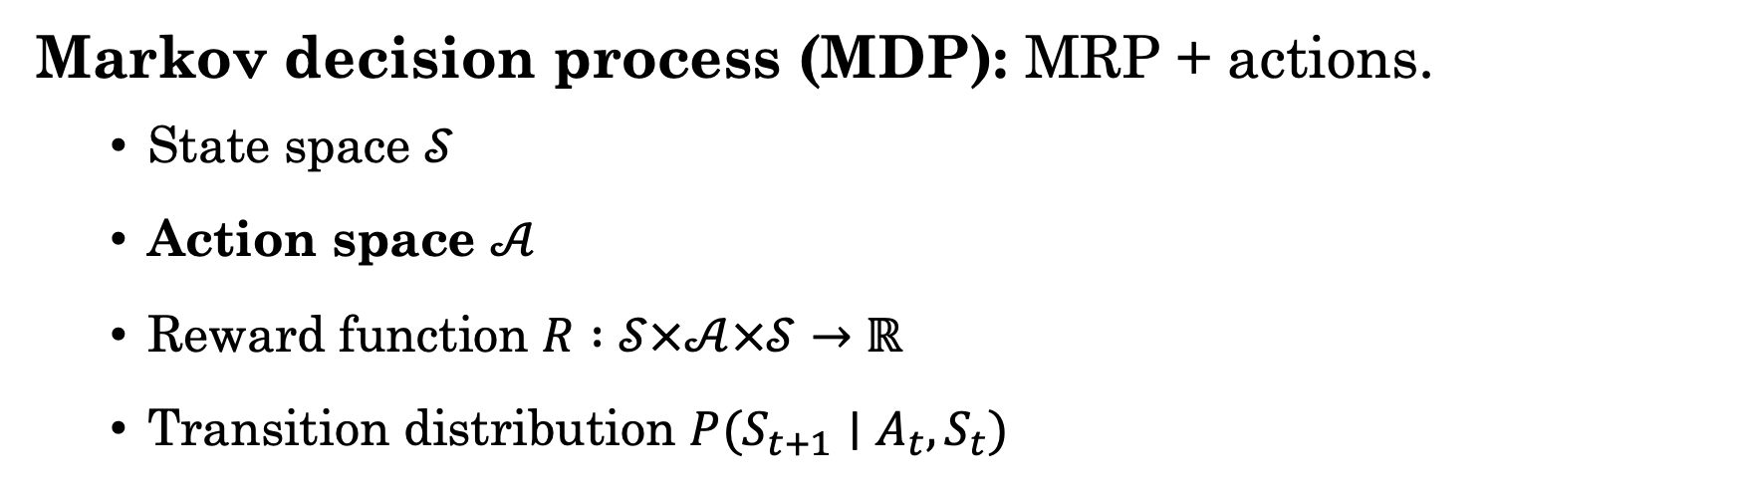
Markov Decision Processes
Markov decision process (MDP): MRP + actions.
State space $𝒮$
Action space $𝒜$
Reward function $R :𝒮×𝒜×𝒮→$ $ℝ$
Transition distribution $P(S_{t+1}∣A_{t}, S_{t})$
$a_{t}$ is action at time $t$
$A_{t}$ is random variable for action at time $t$

Slide 41
Markov Decision Processes
Markov decision process (MDP): MRP + actions.
State space $𝒮$
Action space $𝒜$
Reward function $R :𝒮×𝒜×𝒮→$ $ℝ$
Transition distribution $P(S_{t+1}∣A_{t}, S_{t})$
Reward now depends on action
Transitions now depends on action

Slide 42
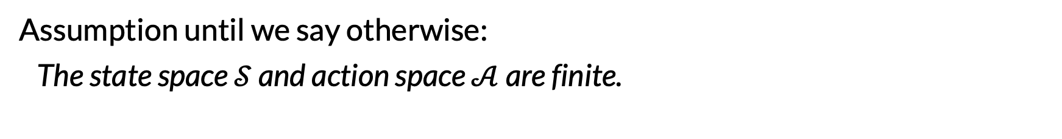
Markov Decision Processes
Markov decision process (MDP): MRP + actions.
State space $𝒮$
Action space $𝒜$
Reward function $R :𝒮×𝒜×𝒮→$ $ℝ$
Transition distribution $P(S_{t+1}∣A_{t}, S_{t})$
Assumption until we say otherwise:
The state space $𝒮$ and action space $𝒜$ are finite.
Not generally true for MDPs. Just convenient for algorithms.

Slide 43
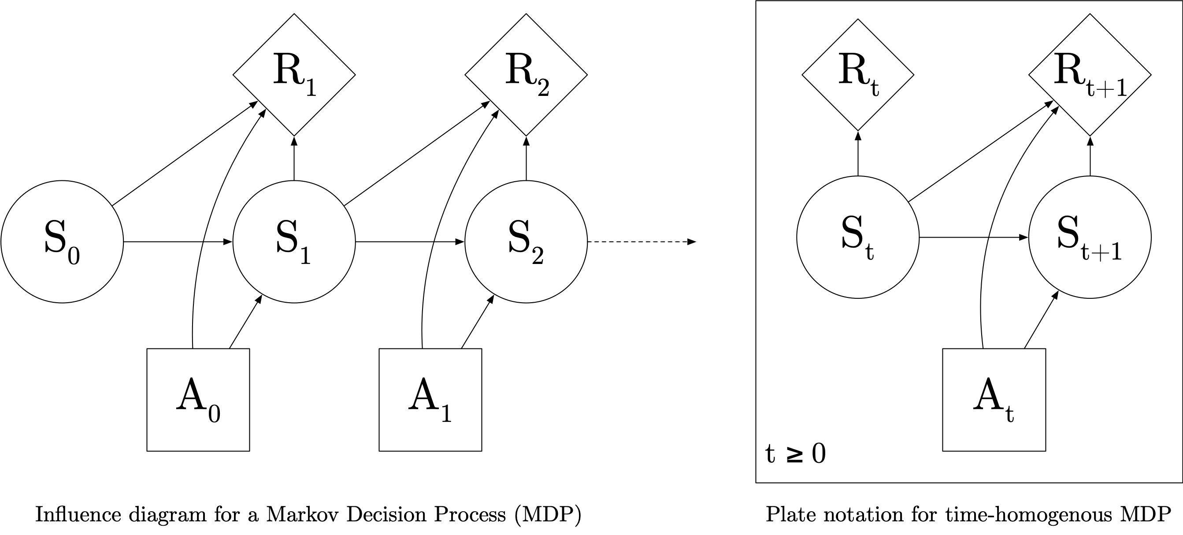
MDP PGM (Influence Diagram)
Influence diagrams can also include “decision nodes” (squares)

Slide 44


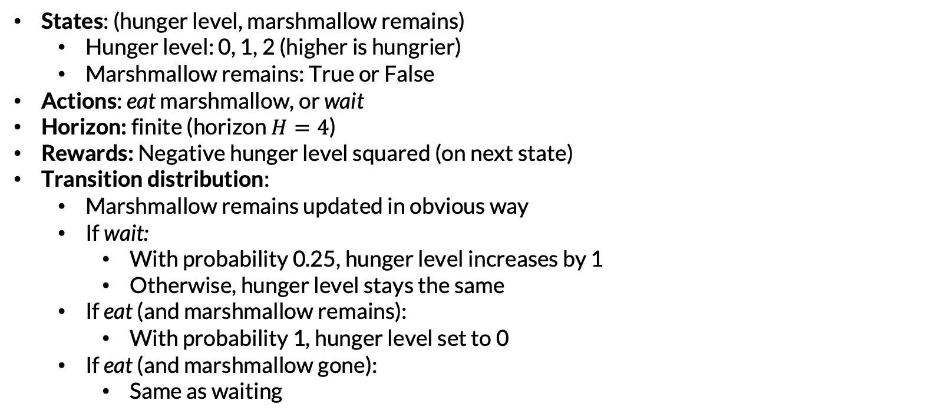
Example: Marshmallows
States: (hunger level, marshmallow remains)
Hunger level: 0, 1, 2 (higher is hungrier)
Marshmallow remains: True or False
Actions: eat marshmallow, or wait
Horizon: finite (horizon $H=4$)
Rewards: Negative hunger level squared (on next state)
Transition distribution:
Marshmallow remains updated in obvious way
If wait:
With probability 0.25, hunger level increases by 1
Otherwise, hunger level stays the same
If eat (and marshmallow remains):
With probability 1, hunger level set to 0
If eat (and marshmallow gone):
Same as waiting

Slide 45

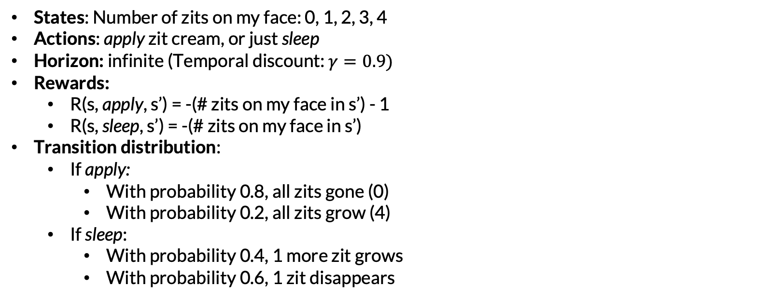
Example: Zits
States: Number of zits on my face: 0, 1, 2, 3, 4
Actions: apply zit cream, or just sleep
Horizon: infinite (Temporal discount: $γ=0.9)$
Rewards:
R(s, apply, s’) = -(# zits on my face in s’) - 1
R(s, sleep, s’) = -(# zits on my face in s’)
Transition distribution:
If apply:
With probability 0.8, all zits gone (0)
With probability 0.2, all zits grow (4)
If sleep:
With probability 0.4, 1 more zit grows
With probability 0.6, 1 zit disappears

Slide 46

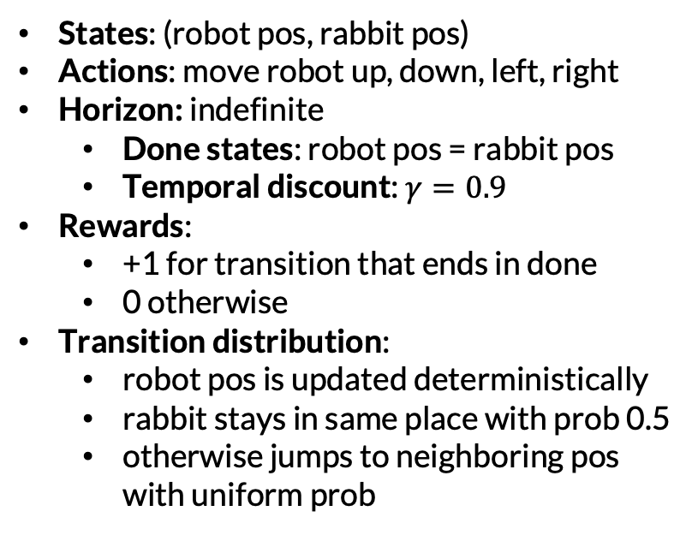
Example: Chase
States: (robot pos, rabbit pos)
Actions: move robot up, down, left, right
Horizon: indefinite
Done states: robot pos = rabbit pos
Temporal discount: $γ=0.9$
Rewards:
+1 for transition that ends in done
0 otherwise
Transition distribution:
robot pos is updated deterministically
rabbit stays in same place with prob 0.5
otherwise jumps to neighboring pos with uniform prob

Slide 47
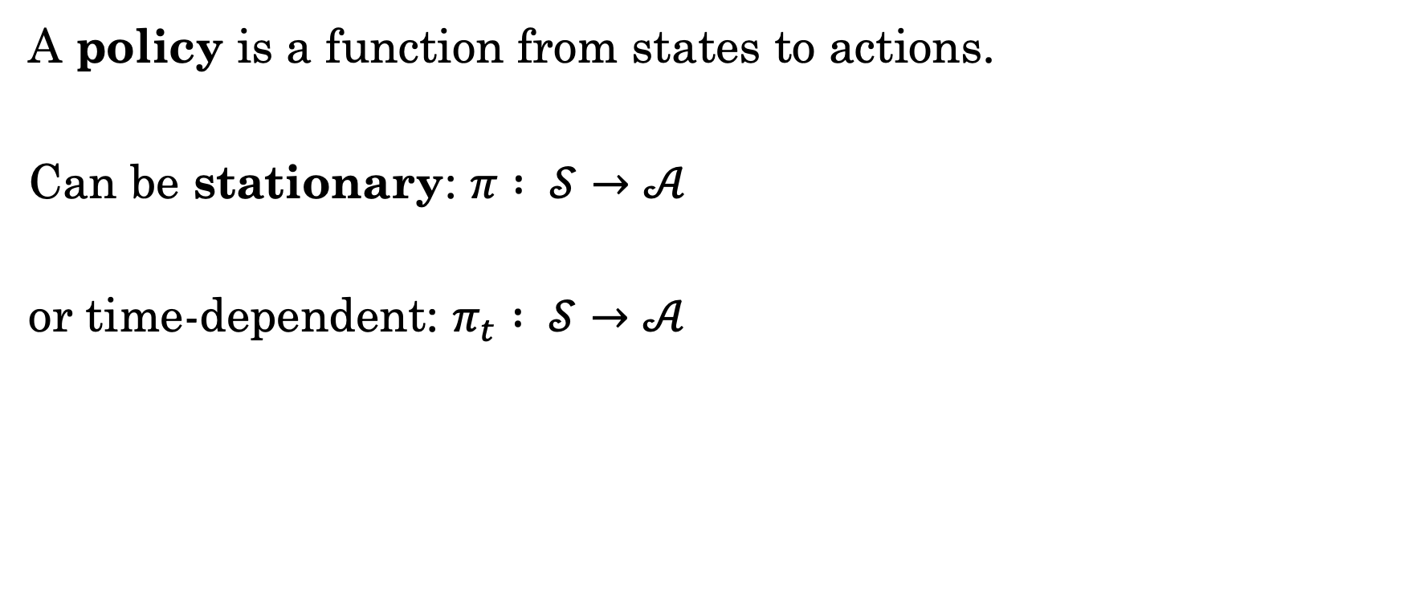
Policies
A policy is a function from states to actions.
Can be stationary: $π : 𝒮→𝒜$
or time-dependent: $π_{t} : 𝒮→𝒜$

Slide 48
Policies
A policy is a function from states to actions.
Can be stationary: $π : 𝒮→𝒜$
or time-dependent: $π_{t} : 𝒮→𝒜$
MDP Planning: Find a “good” policy.
What exactly does “good” mean?

Slide 49
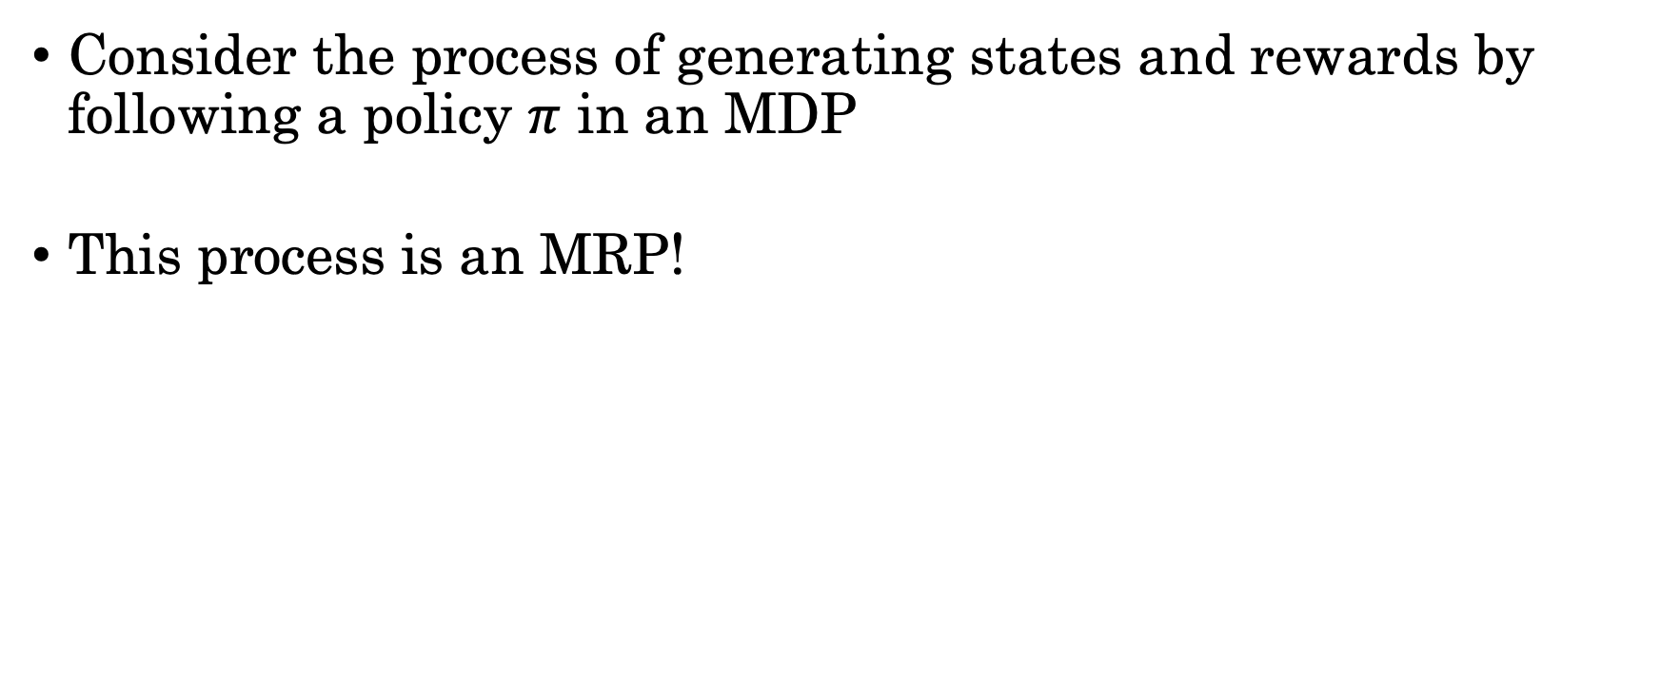
Policy + MDP = MRP
Consider the process of generating states and rewards by following a policy $π$ in an MDP
This process is an MRP!

Slide 50
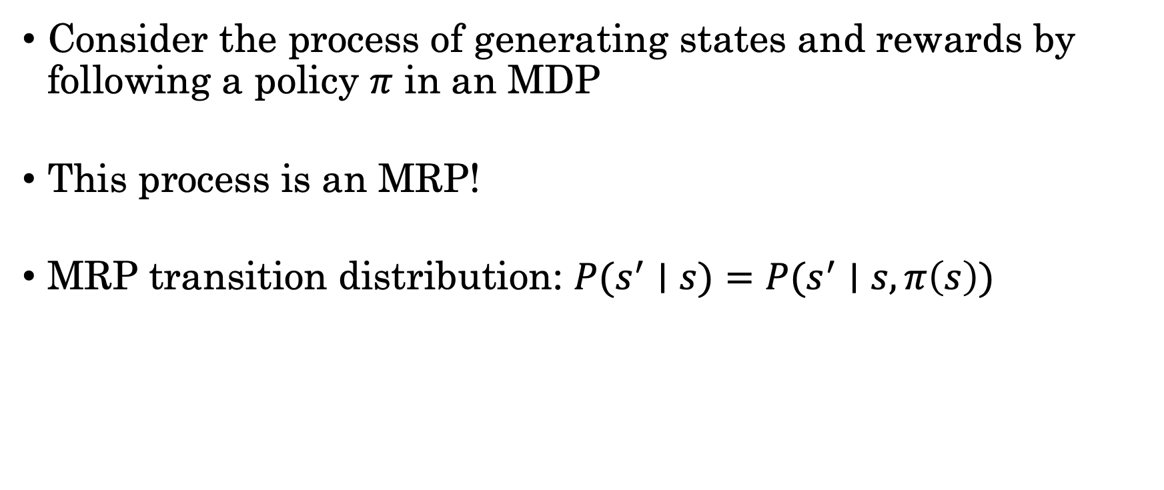
Policy + MDP = MRP
Consider the process of generating states and rewards by following a policy $π$ in an MDP
This process is an MRP!
MRP transition distribution: $P(s^{′}∣s)=P(s^{′}∣s, π\left(s\right))$
From the MDP

Slide 51
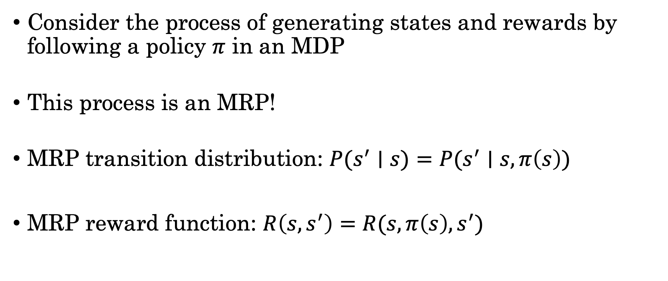
Policy + MDP = MRP
Consider the process of generating states and rewards by following a policy $π$ in an MDP
This process is an MRP!
MRP transition distribution: $P(s^{′}∣s)=P(s^{′}∣s, π\left(s\right))$
MRP reward function: $R\left(s, s^{′}\right)=R(s, π\left(s\right), s^{′})$
From the MDP
From the MDP

Slide 52
MDP
Policy 1
Policy 2
MRP 1
MRP 2
=

Slide 53
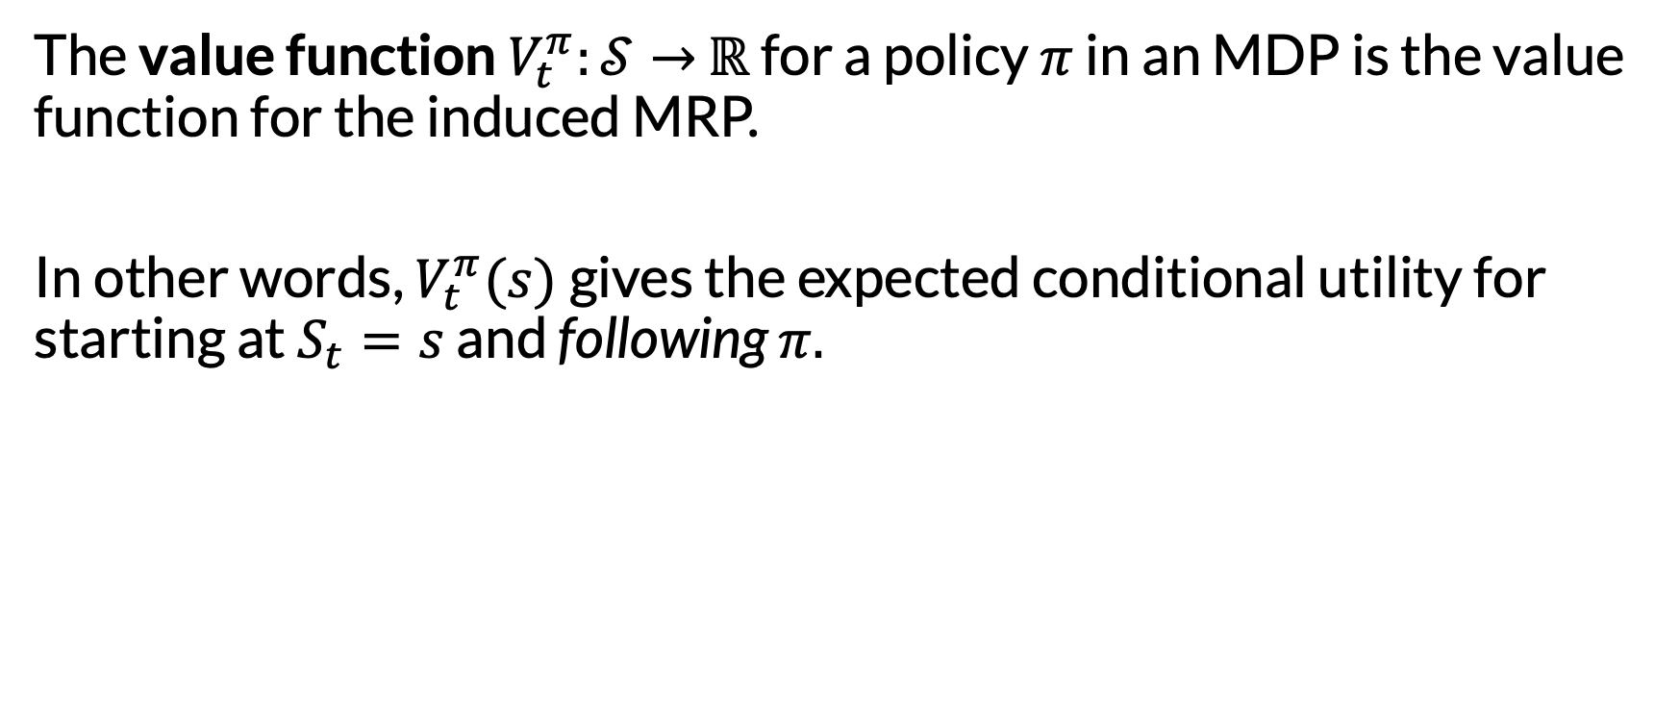
Value Functions for Policies
The value function $V_{t}^{π}:𝒮→$ $ℝ$ for a policy $π$ in an MDP is the value function for the induced MRP.
In other words, $V_{t}^{π}(s)$gives the expected conditional utility for starting at $S_{t}=s$ and following $π.$

Slide 54
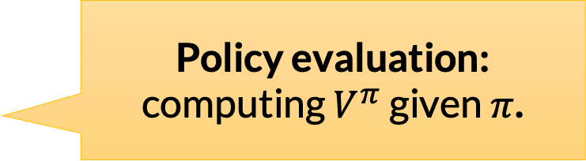
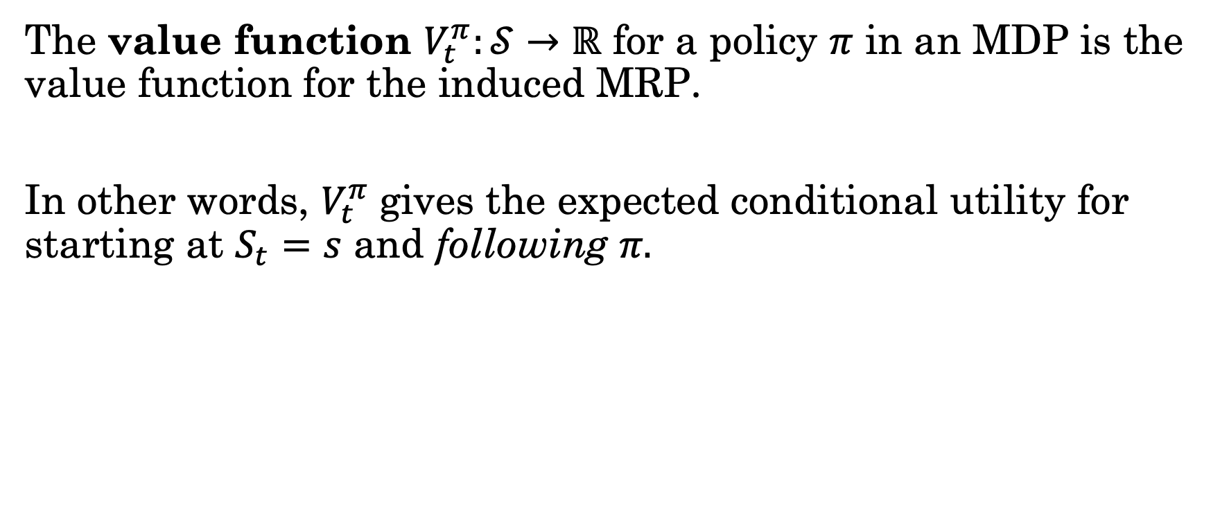
Value Functions for Policies
The value function $V_{t}^{π}:𝒮→$ $ℝ$ for a policy $π$ in an MDP is the value function for the induced MRP.
In other words, $V_{t}^{π}$gives the expected conditional utility for starting at $S_{t}=s$ and following $π.$
Policy evaluation: computing $V^{π}$ given $π$.

Slide 55
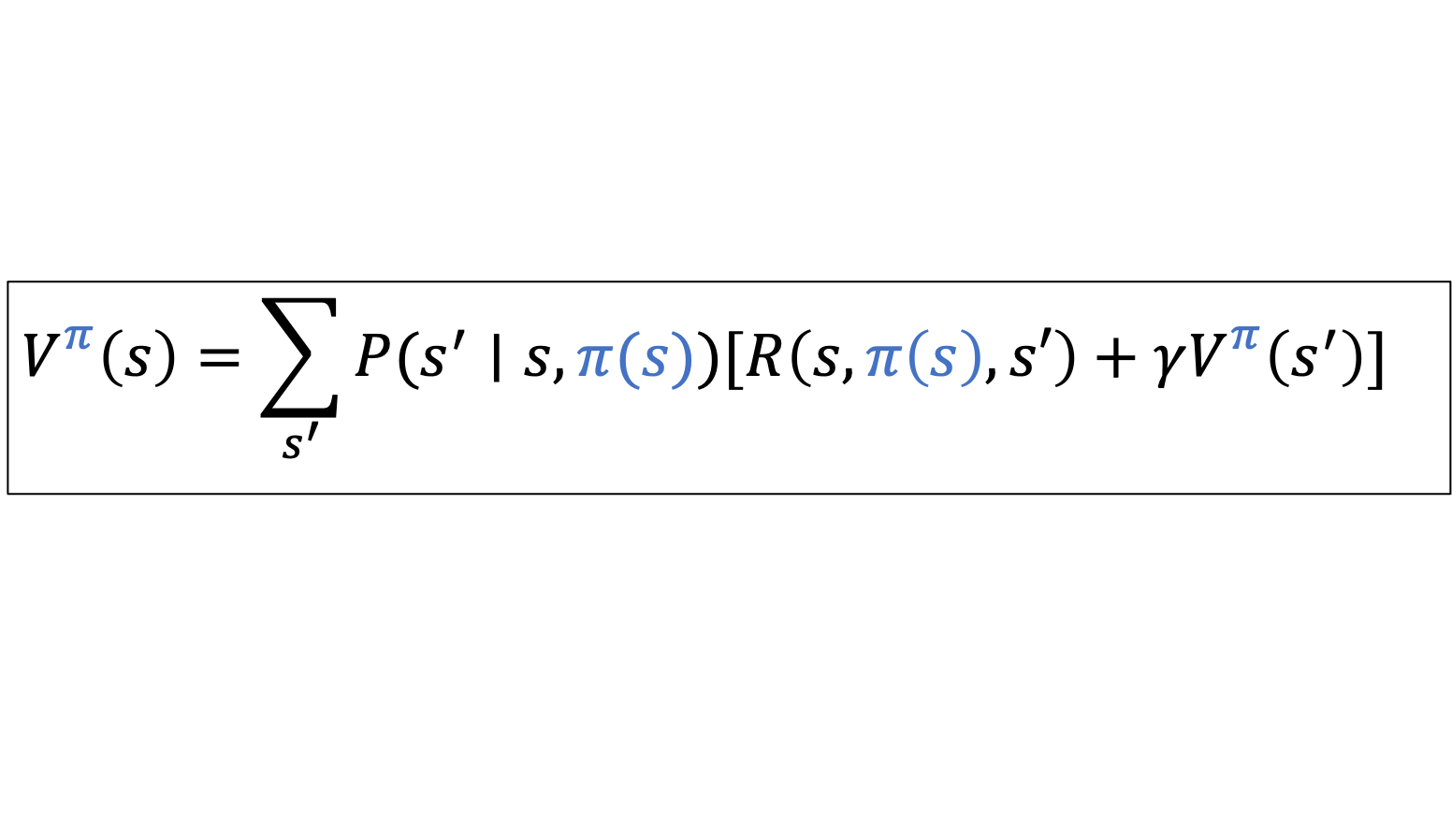
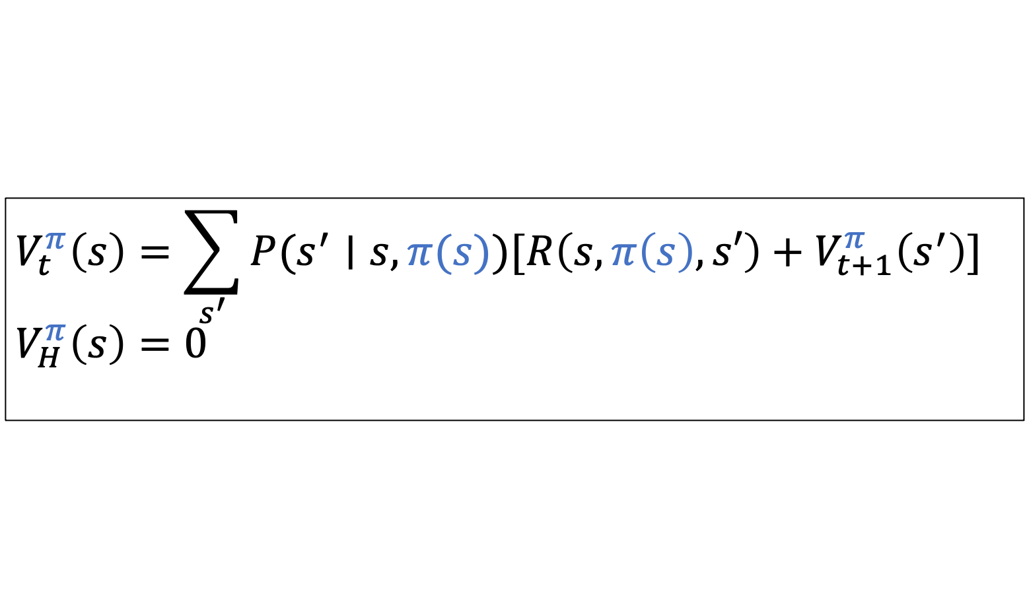
Bellman Equations: Convenient Recursions
Finite Horizon
$$V_{t}^{π}\left(s\right)=\sum_{s^{′}}{P(s^{′}∣s, π(s))[R\left(s, π\left(s\right), s′\right)+V_{t+1}^{π}\left(s^{′}\right)]}$$
$$V_{H}^{π}\left(s\right)=0$$
Infinite Horizon
$$V_{}^{π}\left(s\right)=\sum_{s^{′}}{P(s^{′}∣s, π(s))[R\left(s, π\left(s\right), s′\right)+γV_{}^{π}\left(s^{′}\right)]}$$

Slide 56
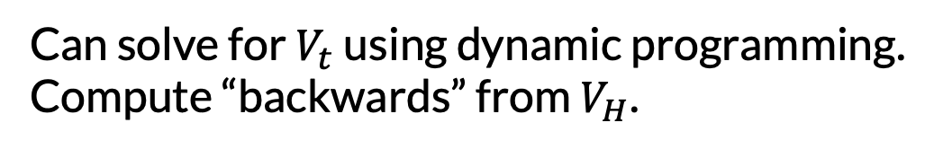
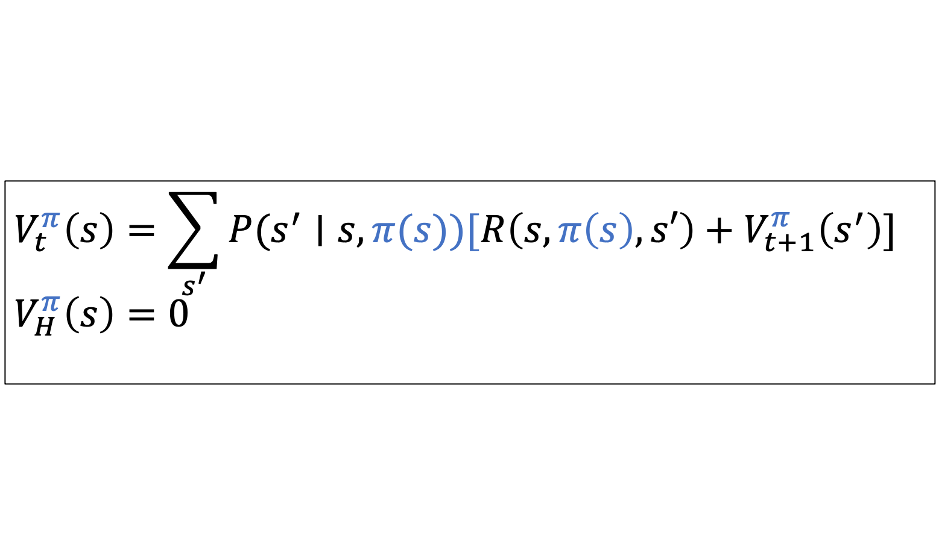
Bellman Equations: Convenient Recursions
Finite Horizon
$$V_{t}^{π}\left(s\right)=\sum_{s^{′}}{P(s^{′}∣s, π(s))[R\left(s, π\left(s\right), s′\right)+V_{t+1}^{π}\left(s^{′}\right)]}$$
$$V_{H}^{π}\left(s\right)=0$$
Can solve for $V_{t}$ using dynamic programming.
Compute “backwards” from $V_{H}$.

Slide 57

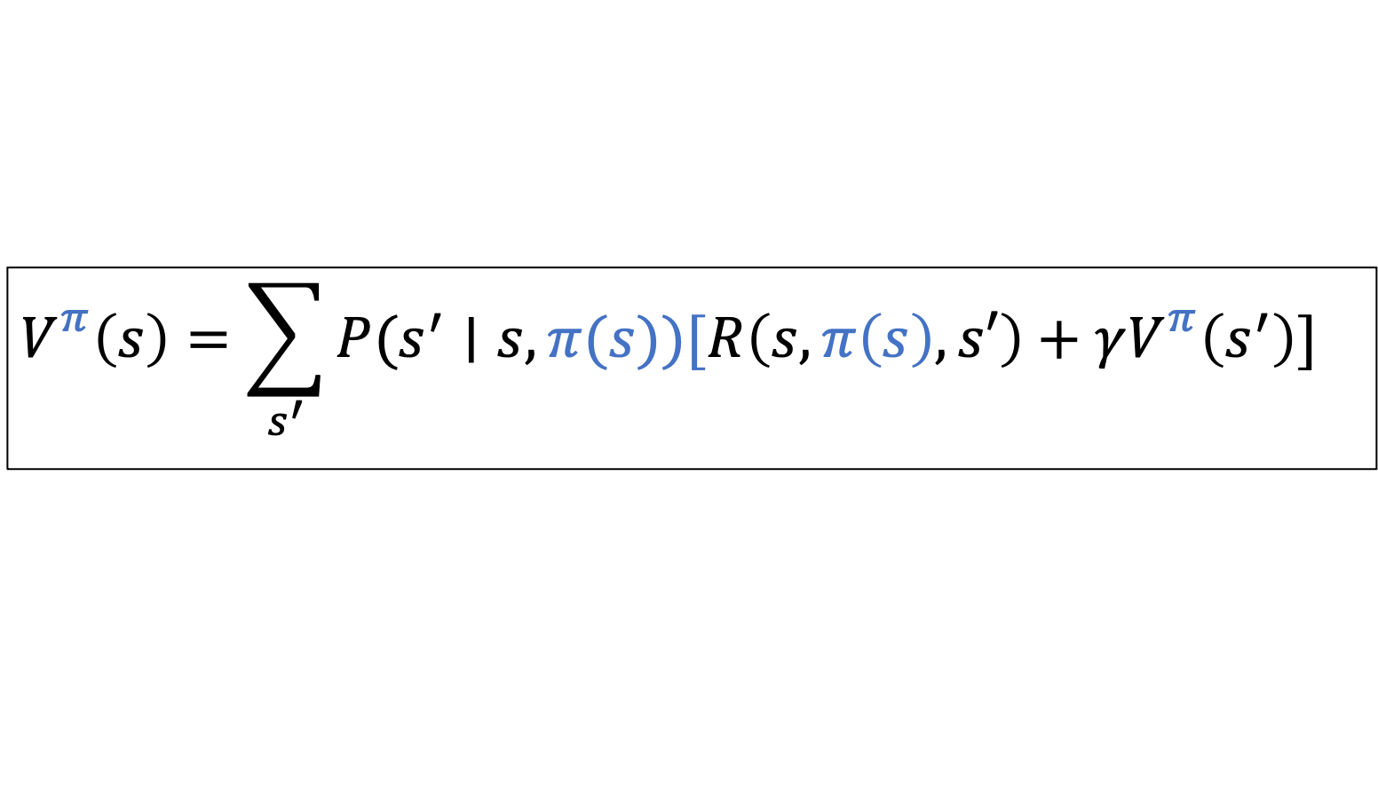
Bellman Equations: Convenient Recursions
This is a system of linear equations with $\left|𝒮\right|$ unknowns and $\left|𝒮\right|$ equations. Can solve for $V$using linear algebra ($≈$cubic time).
Infinite Horizon
$$V_{}^{π}\left(s\right)=\sum_{s^{′}}{P(s^{′}∣s, π(s))[R\left(s, π\left(s\right), s′\right)+γV_{}^{π}\left(s^{′}\right)]}$$

Slide 58
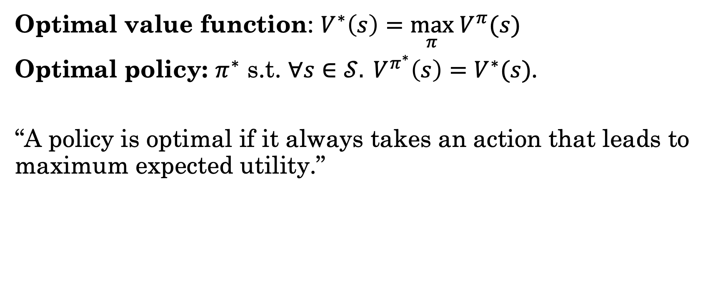
Planning: Finding an Optimal Policy
Optimal value function: $V^{∗}\left(s\right)=\max_{π} V^{π}(s)$
Optimal policy: $π^{∗}$ s.t. ${∀s∈𝒮. V}^{π^{∗}}\left(s\right)=V^{∗}(s)$.
“A policy is optimal if it always takes an action that leads to maximum expected utility.”

Slide 59
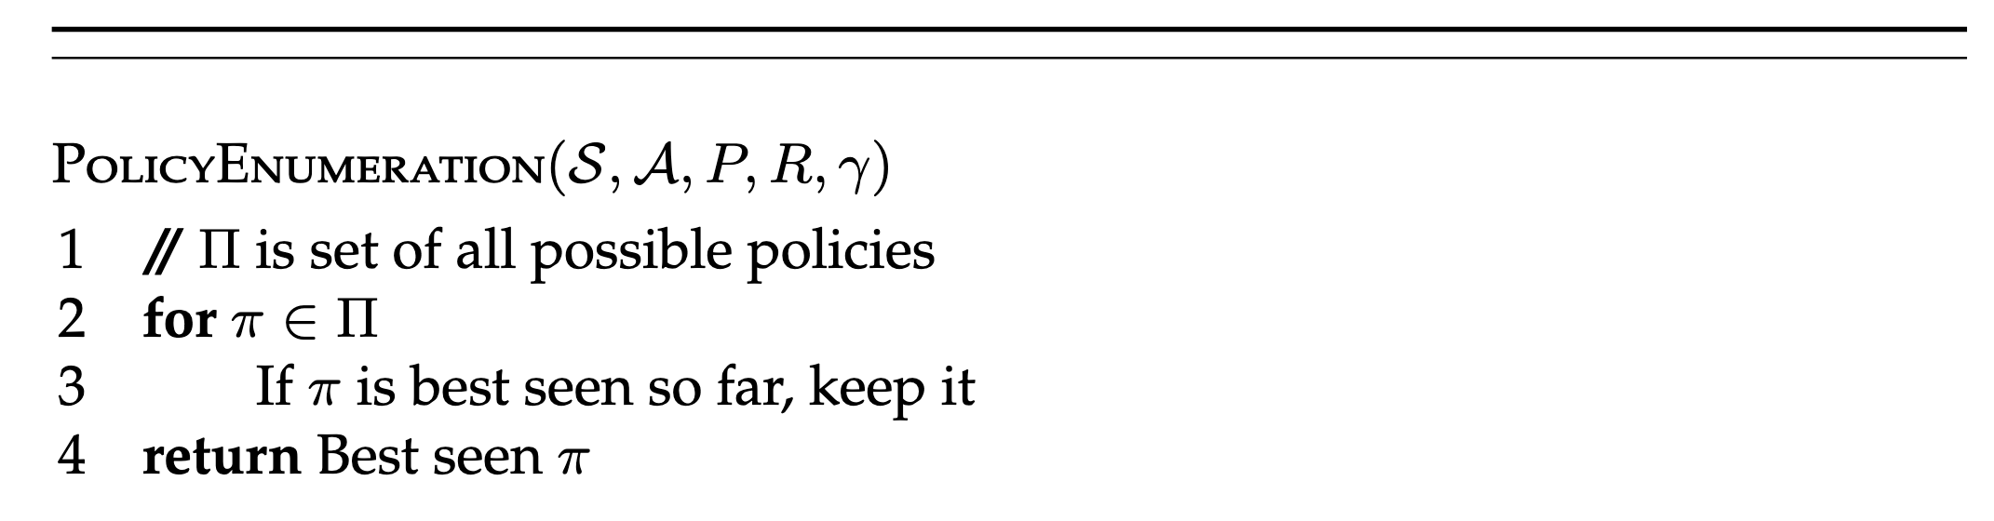
Stupidest Possible Algorithm (SPA) for MDP Planning

Slide 60
Stupidest Possible Algorithm (SPA) for MDP Planning
Review: how would we check this?

Slide 61
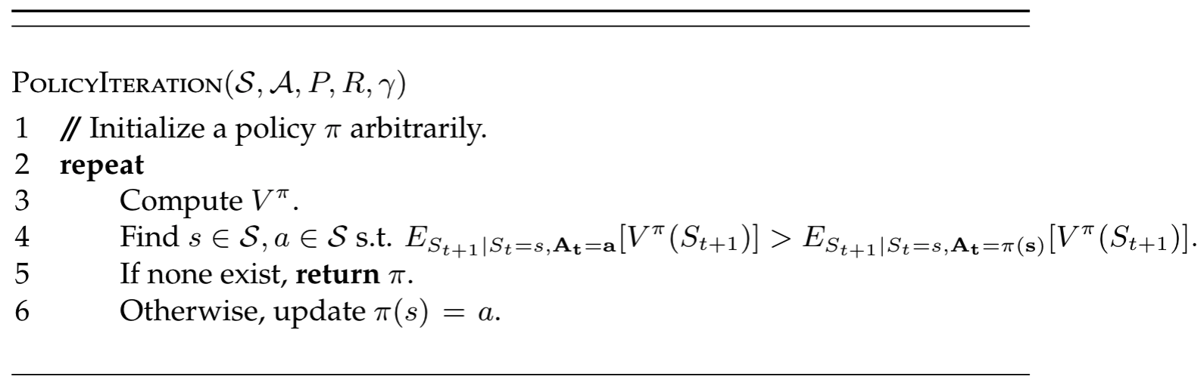
Policy Iteration: A Less Stupid Algorithm
“Find a policy improvement.”

Slide 62
Policy Iteration: A Less Stupid Algorithm
Guaranteed to converge to an optimal policy.

Slide 63
Policy Iteration: A Less Stupid Algorithm
This is ugly, let’s refactor

Slide 64

Action-Value (Q) Functions
The action-value function $Q_{t}^{π}:𝒮×𝒜→$ $ℝ$ gives the expected cumulative rewards for starting at $S_{t}=s$, taking action $A_{t}=a,$ and then following $π$:
$$Q_{t}^{π}\left(s, a\right)=E_{S_{t+1}∣S_{t}=s, A_{t}=a }[R_{t}+V_{t+1}^{π}\left(S_{t+1}\right)]$$

Slide 65

Policy Iteration: Refactored

Slide 66
Avoiding Policy Evaluation
Policy iteration requires evaluating the Bellman equations in the inner loop, which can be expensive
Rather than keeping track of a policy, what if we compute an optimal value function directly?
Once we have the optimal value function, we can compute a corresponding optimal policy at the end

Slide 67

Value Function → Policy
Given an action-value function $Q$, a greedy policy is:
$$π\left(s\right)={argmax}_{a }Q(s, a)$$

Slide 68

Value Function → Policy
Given an action-value function $Q$, a greedy policy is:
$$π\left(s\right)={argmax}_{a }Q(s, a)$$
If we have an optimal action-value function $Q^{∗}$, the greedy policy is an optimal policy:
$$π^{∗}\left(s\right)={argmax}_{a }Q^{∗}(s, a)$$

Slide 69
Value Function → Policy
Given an action-value function $Q$, a greedy policy is:
$$π\left(s\right)={argmax}_{a }Q(s, a)$$
If we have an optimal action-value function $Q^{∗}$, the greedy policy is an optimal policy:
$$π^{∗}\left(s\right)={argmax}_{a }Q^{∗}(s, a)$$
Are greedy policies unique?

Slide 70

Value Function → Policy
Given an action-value function $Q$, a greedy policy is:
$$π\left(s\right)={argmax}_{a }Q(s, a)$$
If we have an optimal action-value function $Q^{∗}$, the greedy policy is an optimal policy:
$$π^{∗}\left(s\right)={argmax}_{a }Q^{∗}(s, a)$$
So, how can we directly compute $V^{∗}$ / $Q^{∗}$?

Slide 71

Bellman Equations: Convenient Recursions
Finite Horizon
$$V_{t}^{∗}\left(s\right)=\max_{a}{\sum_{s^{′}}{P(s^{′}∣s,a)[R\left(s, a, s′\right)+V_{t+1}^{∗}\left(s^{′}\right)]}}$$
$$V_{H}^{∗}\left(s\right)=0$$

Slide 72

Bellman Equations: Convenient Recursions
Finite Horizon
$$V_{t}^{∗}\left(s\right)=\max_{a}{\sum_{s^{′}}{P(s^{′}∣s,a)[R\left(s, a, s′\right)+V_{t+1}^{∗}\left(s^{′}\right)]}}$$
$$V_{H}^{∗}\left(s\right)=0$$
Can solve for $V_{t}^{∗}$ using dynamic programming.
Compute “backwards” from $V_{H}^{∗}$.

Slide 73

Compute Optimal Value Functions: Finite Horizon

Slide 74
Compute Optimal Value Functions: Finite Horizon
Example of dynamic programming
What’s the asymptotic complexity?

Slide 75
Example: Marshmallows
States: (hunger level, marshmallow remains)
Hunger level: 0, 1, 2 (higher is hungrier)
Marshmallow remains: True or False
Actions: eat marshmallow, or wait
Horizon: finite (horizon $H=4$)
Rewards: Negative hunger level squared (on next state)
Transition distribution:
Marshmallow remains updated in obvious way
If wait:
With probability 0.25, hunger level increases by 1
Otherwise, hunger level stays the same
If eat (and marshmallow remains):
With probability 1, hunger level set to 0
If eat (and marshmallow gone):
Same as waiting

Slide 76
Initialization (H=4)
V[4][0T] = 0, V[4][1T] = 0, V[4][2T] = 0, V[4][0F] = 0, V[4][1F] = 0, V[4][2F] = 0

Slide 77
Initialization (H=4)
V[4][0T] = 0, V[4][1T] = 0, V[4][2T] = 0, V[4][0F] = 0, V[4][1F] = 0, V[4][2F] = 0
Iteration (H=3)
V[3][0T] = max(
… // Eat
… // Wait
)

Slide 78
Initialization (H=4)
V[4][0T] = 0, V[4][1T] = 0, V[4][2T] = 0, V[4][0F] = 0, V[4][1F] = 0, V[4][2F] = 0
Iteration (H=3)
V[3][0T] = max(
P(0F | E, 0T)(R(0T, E, 0F) + V[4][0F])
… // Wait
)
Zero-prob transitions not written
Eat → 0F

Slide 79
Initialization (H=4)
V[4][0T] = 0, V[4][1T] = 0, V[4][2T] = 0, V[4][0F] = 0, V[4][1F] = 0, V[4][2F] = 0
Iteration (H=3)
V[3][0T] = max(
P(0F | E, 0T)(R(0T, E, 0F) + V[4][0F])
P(0T | W, 0T)(R(0T, W, 0T) + V[4][0T]) + P(1T | W, 0T)(R(0T, W, 1T) + V[4][1T])
)
Eat → 0F
Wait → 0T
Wait → 1T

Slide 80
Initialization (H=4)
V[4][0T] = 0, V[4][1T] = 0, V[4][2T] = 0, V[4][0F] = 0, V[4][1F] = 0, V[4][2F] = 0
Iteration (H=3)
V[3][0T] = max(
P(0F | E, 0T)(R(0T, E, 0F) + V[4][0F])
P(0T | W, 0T)(R(0T, W, 0T) + V[4][0T]) + P(1T | W, 0T)(R(0T, W, 1T) + V[4][1T])
)
= max(
1 * (0 + 0) 0.75 * (0 + 0) + 0.25 * (-1 + 0)
) = 0
...

Slide 81
Bellman Backups
The meat of the value function update was this:
Important enough that we will give it a name: Bellman backup
Bellman, because of the Bellman equation.
Backup, because we’re looking one step ahead and “backing up”.

Slide 82

Compute Optimal Value Functions: Finite Horizon
Refactored

Slide 83

Bellman Equations: Convenient Recursions
No longer linear! What to do?
Idea: iteratively “plug in” the RHS to update the LHS.
Infinite Horizon
$$V_{}^{∗}\left(s\right)=\max_{a}{\sum_{s^{′}}{P(s^{′}∣s, a)[R\left(s, a, s′\right)+γV_{}^{∗}\left(s^{′}\right)]}}$$

Slide 84

Value Iteration

Slide 85


Slide 86
Value Iteration (Continued)
What’s the asymptotic complexity per-iteration?

Slide 87

Value Iteration (Continued)
What’s the asymptotic complexity per-iteration?
$O({\left|𝒮\right|}^{2}\left|𝒜\right|)$

Slide 88

Value Iteration (Continued)
What’s the asymptotic complexity per-iteration?
$O({\left|𝒮\right|}^{2}\left|𝒜\right|)$
How should we check convergence?
For theoretical guarantees, use $\max_{s} \left| V\left(s\right)−Vn\left(s\right)\right|<ε$.

Slide 89

Value Iteration (Continued)
What’s the asymptotic complexity per-iteration?
$O({\left|𝒮\right|}^{2}\left|𝒜\right|)$
How should we check convergence?
For theoretical guarantees, use $\max_{s} \left| V\left(s\right)−Vn\left(s\right)\right|<ε$.
Is this guaranteed to converge to the optimal value function?
(Thm) Yes.

Slide 90

Value Iteration (Continued)
What’s the asymptotic complexity per-iteration?
$O({\left|𝒮\right|}^{2}\left|𝒜\right|)$
How should we check convergence?
For theoretical guarantees, use $\max_{s} \left| V\left(s\right)−Vn\left(s\right)\right|<ε$.
Is this guaranteed to converge to the optimal value function?
(Thm) Yes.
Does the initialization matter?
Asymptotically, no, but it can affect the rate of convergence. (Extreme case: initialize to optimal.)

Slide 91

Why Does Value Iteration Work?
Each iteration maps one value function $V$ to another, $Vn$
We can think about this map as a function $B :ℝ^{|𝒮|}→$ $ℝ^{|𝒮|}$
Here we are representing a value function as a vector

Slide 92




Why Does Value Iteration Work?
Each iteration maps one value function $V$ to another, $Vn$
We can think about this map as a function $B :ℝ^{|𝒮|}→$ $ℝ^{|𝒮|}$
Here we are representing a value function as a vector
Example: $\left|𝒮\right|=2.$ Three different initializations.

Slide 93


Why Does Value Iteration Work?
$B$ is a contraction mapping*
There exists some $k$ s.t. for any two inputs $v, v′$,
$distance\left(B(v), {B(v}^{′})\right)≤k distance(v, v^{′})$.
That is, all pairs of points get closer after the mapping is applied.
For us, distance is $L_{∞}$-norm.
*Short proof: http://www.cs.cmu.edu/afs/cs/academic/class/15780-s16/www/slides/mdps.pdf Slide 19.

Slide 94

Why Does Value Iteration Work?
$B$ is a contraction mapping*
There exists some $k$ s.t. for any two inputs $v, v′$,
$distance\left(B(v), {B(v}^{′})\right)≤k distance(v, v^{′})$.
That is, all pairs of points get closer after the mapping is applied.
Theorem (Banach fixed point theorem): If $B$ is a contraction mapping, it has a unique fixed point.
For us, that unique fixed point is the optimal value function.
*Short proof: http://www.cs.cmu.edu/afs/cs/academic/class/15780-s16/www/slides/mdps.pdf Slide 19.

Slide 95
Policy Iteration vs. Value Iteration
PI typically needs fewer iterations than VI to converge
However, each iteration of PI requires policy evaluation
Modified PI (Putterman & Shin, 1978) performs a cheaper approximate policy evaluation. Often the best in practice
But with modern compute, if you have an MDP that is practically too big for VI, then it’s probably too big for PI and MPI as well, and you need approximate methods

Slide 96

Linear Programming
Compute value function by solving linear program:
Less widely used. But, tightest complexity bounds!
And, the basis for some other approximate methods, with connections to other communities.

Slide 97

Next Time
What if $𝒮$ is very large?
If we know our current state, could we leverage it?
How can we incorporate heuristics?

Slide 98
All-Source Shortest Paths
Consider: indefinite horizon, deterministic transitions.
Want to solve for value function.

Slide 99
All-Source Shortest Paths
Consider: indefinite horizon, deterministic transitions.
Want to solve for value function.
You may have seen graph search algorithms for this:
Bellman-Ford
Dijkstra’s (faster, but assumes all rewards nonzero)
Very similar to value iteration!
Conventionally, costs instead of rewards (so, all costs nonnegative)

Slide 100

Applications of MDPs
Value iteration, policy iteration, LP are the foundation
Most planning and (reinforcement) learning methods for MDPs build on one of these
Approximate methods used a lot in practice
“A survey of applications of Markov decision processes.” White (1993).

